Slide 1



Newsthink.
Afghanistan crisis

Slide 2

Newsthink
Afghanistan crisis
Learning objectives:
Examine and discuss an image related to a current humanitarian news event
Analyze and identify how people are impacted by this event
Discuss and debate a statement relating to a core value by explaining whether you agree or disagree

Slide 3
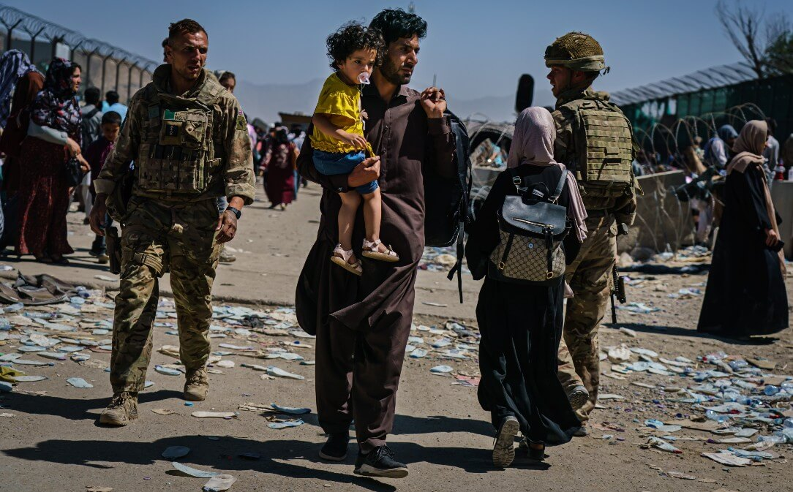
Newsthink
Afghanistan crisis
See: What do you see in the picture? What’s happening?
Notes:
Support leaners by explaining:
This is an image of a man and his child in the Kabul airport in August 2021 while thousands of people were trying to flee their country and homes after the Taliban, a militant group that used to rule the country in the 1990s, took power again. People in Afghanistan have been affected by conflict and war for so many years. Today millions of people are experiencing severe food shortages and hunger – made worse by decades of conflict, chronic poverty and years of extreme drought. Recent escalation in violence and conflict has made the country unsafe for people and have left thousands of people injured, and homes, hospitals and infrastructure badly damaged. Some people were evacuated, while many got injured or lost their lives in an attempt to flee to a safer place. Some Afghan people have come to the UK as asylum seekers: people who seek the right to live in another country because where they currently live is not safe. Many more must now remain in Afghanistan.

Slide 4
Newsthink.
Afghanistan crisis
Think: What do you think these people are thinking about? What is important to them at this moment?
Notes:
Support learners by asking them to consider the situation.
What might someone be thinking if they suddenly had to leave their home? What might they try and take with them? Where might they try flee to?
Encourage learners to think about whether each person in the picture has the same concerns? What might the man carrying his child be thinking? What might the young girl with the backpack be thinking? What about the soldiers?

Slide 5
Newsthink.
Afghanistan crisis
Feel: How do you think they feel? Why might they feel this way?
Notes:
Support learners by asking them to consider the situation.
Are they all feeling the same? What might each person in the photo be thinking?

Slide 6


Newsthink.
Afghanistan crisis
“Everyone deserves to be safe.”
Agree
Disagree
Notes:
Give learners the opportunity to share their answers. Once they’ve listened to each other’s arguments, give them a chance to review their position. If they wish to change sides, encourage them to do so.
You could ask them to go to one side of the classroom for “agree” and the opposite side for “disagree”. Remind learners that people may have different opinions and that’s fine. Ask learners to explain their position. Remind everyone that the classroom is a safe space to share their opinions. If possible, help learners to find commonalities in their opinions.

Slide 7

Newsthink.
Afghanistan crisis
Reflect on your own:
What are your thoughts and feelings about this image and the events you talked about?
Notes:
This is an extension task for personal reflection. Encourage learners to reflect on this activity, whether writing it down or just thinking. Having a private place to reflect is important.
Likewise, if they’d like to talk more about this topic or any feelings it may have brought up, remind them who they can go and speak to.

Slide 8



Newsthink.
Afghanistan crisis
Learn more:
Learn more about Conflict and its consequences and Refugees and migration
Share with others:
Share what you’ve learned with others. Show them the image, discuss the debate with them, or reflect together on how you feel about this event.
Do something:
You can help people by donating to the Afghanistan crisis appeal
Notes:
Some ideas of what you and your learners can do next. Use other teaching resources to explore the topic in more detail. Encourage learners to share their learning with peers or family. Want to do something to help? Consider arranging a fundraiser to donate to our Afghanistan crisis appeal or show your support for refugees by joining our Every Refugee Matters campaign https://www.redcross.org.uk/get-involved/every-refugee-matters

