Slide 1





Weather Together: flooding – how it affects everyone
Weather Together: flooding – how it affects everyone
15 Minutes
Success criteria
Must know that flooding can affect anyone.
Could take part in a discussion explaining how flooding can affect anyone.
Whole group
Discussion
Invite learners to take a pause [3].
Review the objective, and the big question [4,5].
Work through 3 characters describing where they live. They each explain that flooding affected them. Invite learners to discuss how. See the guidance in the ‘notes’ for support. Address any misconceptions. [6-9].
Refer back to the big question to review progress [10].
Learn why you need to prepare for a flood emergency.
How to run the activity
What you need
Ways to
adapt
Invite learners to work in small groups to explain how flooding could have affected each character. Support them by providing a digital/paper copy of the slides.
To engage learners more, have them play the role of flood investigators. You could provide props like a magnifying glass. Ask them to spot the clues in each character’s description to work out how flooding could affect them.
Provide peer support by encouraging learners to read descriptions to each other.
Curriculum links
England: PSHE, Language and literacy
Scotland: Health and wellbeing, Literacy
Wales: Health and Wellbeing, Languages, Literacy and Communication
Northern Ireland: Communication, Thinking skills and personal capabilities,
Language and literacy
The British Red Cross Society © 2023 incorporated by Royal Charter 1908, is a charity registered in England and Wales (220949), Scotland (SC037738) and Isle of Man (0752)
Notes:
As Weather Together is about emergencies, it has the potential to affect learners who have been impacted by trauma in their lives. This trauma may have been related to an emergency event, or it may relate to something else. Careful consideration should be given before deciding to ask learners to share their personal feelings about past or future emergencies or traumas. If a learner brings up personal feelings, you could validate their feelings and then redirect them back to the discussion or activity.
Please always refer to your organisation’s safeguarding policy should you have any concerns about learner wellbeing.

Slide 2

Screensaver
Notes:
This is a screen saver which you could use while settling the group.

Slide 3



Pause
This is a three-minute activity.
Sit up, place your feet flat on the ground and put your hands in your lap. You might like to close your eyes.
Spend one minute inwardly (to yourself) answering, ‘how am I right now?’ Focus on your emotions, how your body feels, and your thoughts.
Spend the next minute focussing on your breath. Notice how your nose/mouth feel as you breathe in and out.
Spend the last-minute noticing how this feels in the rest of your body.
Take a pause
breathing space
Notes:
You can explain that it can be distressing to listen to other’s experience of the challenges they’re facing, especially if we have similar experiences and challenges. A way of coping with this is to take a pause. Remind learners this is a way of being kind to ourselves which is important. How our body feels matters.
Prompt learners to move through the steps.

Slide 4

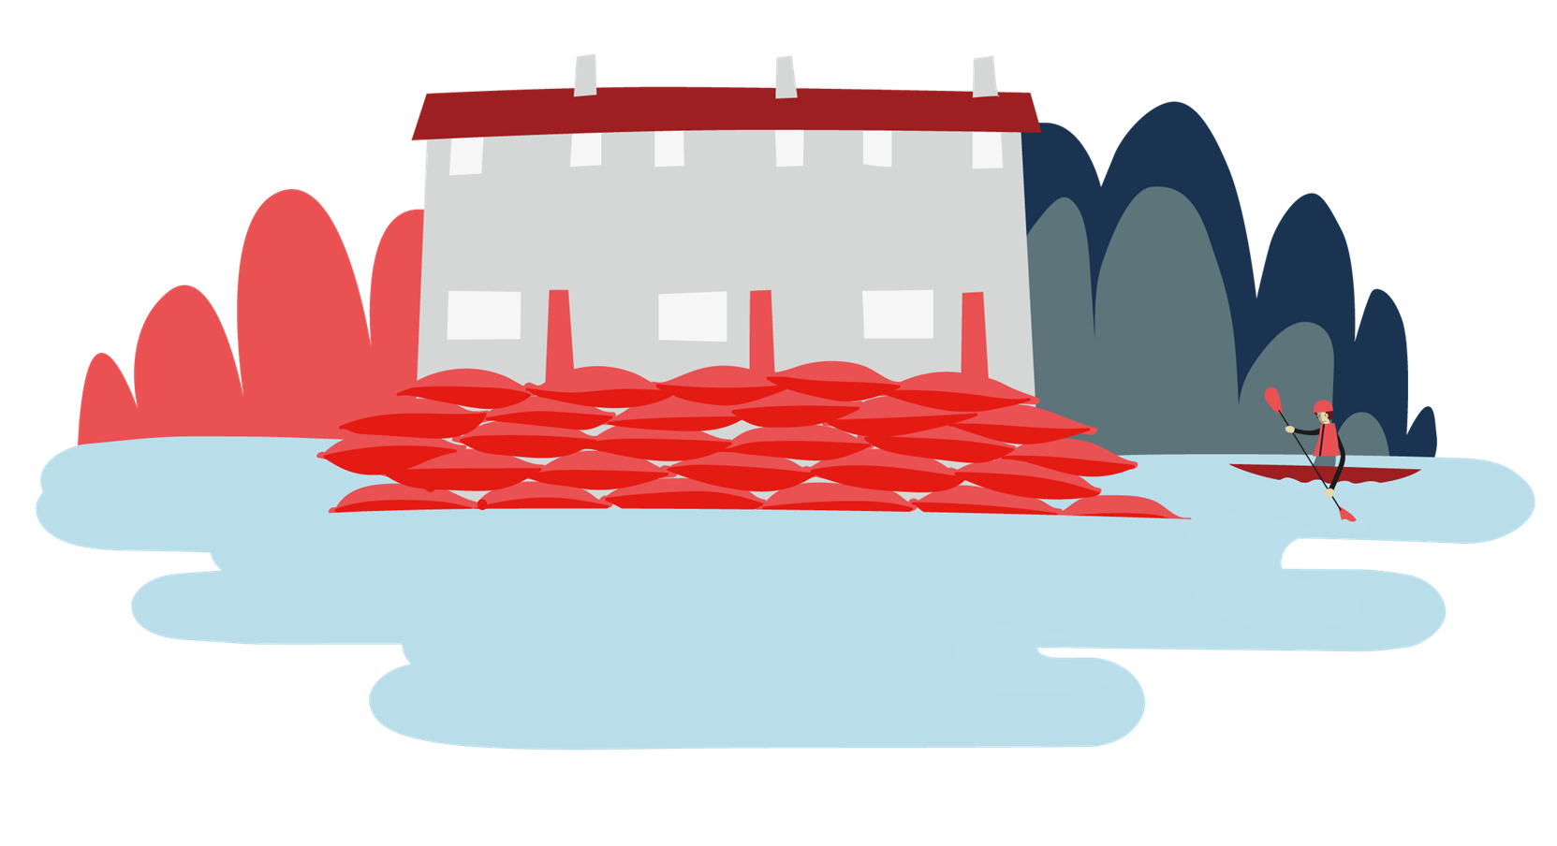

Objective
Welcome
Objective: Learn why you need to prepare for a flood emergency.
To meet this objective, you will listen to the stories of 3 people who live in different places and consider how flooding could affect them.

Slide 5
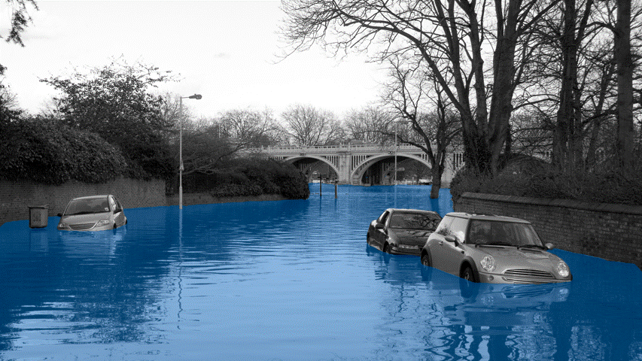

Big question
Can flooding affect all of us?
Notes:
Big questions are an assessment tool for educators and learners to demonstrate progress through an activity.​​
Share this slide with learners and give them a moment to reflect on the question.​​
Then, ask them to discuss with a partner before sharing their ideas with the group.​​
At this point in the activity, it is expected that learners may not have many ideas or know how to answer this question. ​​
The question will be reviewed at the end of the activity. This is an opportunity for learners to see how much progress they’ve made and how many more ideas they now have. ​​
​​

Slide 6


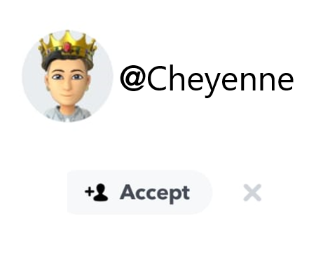
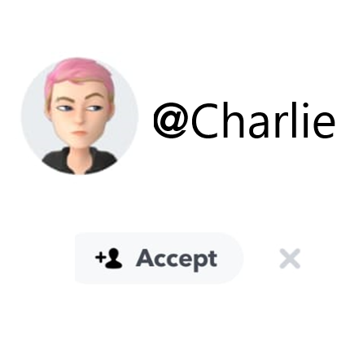
Hear these three people’s flood stories
Stories
How do you think flooding affected them?
@Femi
@Cheyenne
Make notes as you listen.
Discuss how flooding could affect them.
@Charlie
Notes:
Draw learners attention to the question. This question will scaffold them to answer the big question.
Click each photo to read the descriptions.
Click the arrows to navigate.
Optional, encourage learners to make notes as they go through each character’s description. This will help them to reflect in more detail later.

Slide 7

Meet Femi
Where I live, it’s high up on a hill. The whole area is pretty hilly.
Femi
I live in a semi-detached house with my dad.
We’ve got quite a good-sized garden where we grow potatoes, herbs, veg, things like that.
The town centre is about 10 minutes by bus. I go to school there and my dad works in the centre too.
I never thought we could be affected by flooding, but we were when the town centre was flooded.
Notes:
Read the character’s description together. Optionally, prompt learners to make notes.
Encourage learners to work out how flooding could affect someone living on a hill.
Support them with these questions:
How could flooding in the town centre affect Femi?
What is there in the town centre that Femi relies on which could be affected by flooding?
(school, shops, electricity, phones, transport)
What could the flooding in the town centre stop Femi from doing?

Slide 8
Meet Charlie
I live in a small village. If I want to get anywhere, I have to take the bus or ask for a lift.
Charlie
It’s beautiful here, and quiet, but it can get annoying when I want to see my friends. None of them live in this village.
My school is in the town a few miles away. There’s no shops.
My area has never had any trouble with flooding. So, I didn’t think we could ever be affected.
After heavy rains, the roads and fields and surrounding areas were full of water.
Notes:
Read the character’s description together. Optionally, prompt learners to make notes.
Encourage learners to work out how flooding could affect someone who lives in the countryside, in a village.
Support them with these questions:
How does Charlie get to school, to see their friends?
How could flooding on roads affect this?
How do you think Charlie’s parents get food and supplies? (They have to travel to the local town or order online and it is delivered.)
How could flooding on roads affect this?
What would happen if there was an emergency at Charlie’s house – who would help?
How could flooding on roads affect this?

Slide 9
Meet Cheyenne
I live in a flat in the middle of the city.
Cheyenne
I live with my aunt and sib on the 5th floor.
The views are great; you can see for miles out of the window in my room.
Because we live high up, I never thought we could be affected by flooding.
After really heavy rain, for about a week, the river overflowed and all the flats on the ground floor were flooded.
Notes:
Read the character’s description together. Optionally, prompt learners to make notes.
Encourage learners to work out how flooding could affect someone who lives high up in a flat.
Support them with these questions:
If the ground floor flats were flooded, where else would you expect flooding? (all the surrounding areas including any shops, park etc)
What will Cheyenne not be able to do now because of the flooding? (she shouldn’t go outside because flood water is dangerous, so she would not be able to go anywhere).
Flooding can cause electricity, water and gas to go off, how could this affect Cheyenne?
What do you think Cheyenne should do?
Is there anything Cheyenne and her family might wish they had done before this flooding happened?

Slide 10
Big question
Can flooding affect all of us?
Notes:
Big questions are an assessment tool for educators and learners to demonstrate progress through an activity.​​
Share this slide with learners and give them a moment to reflect on the question.​​
Then, ask them to discuss with a partner before sharing their ideas with the group.​​
At this point in the activity, it is expected that learners may not have many ideas or know how to answer this question. ​​
The question will be reviewed at the end of the activity. This is an opportunity for learners to see how much progress they’ve made and how many more ideas they now have. ​​
​​

Slide 11

End
Thank you

Slide 12
Resources and support

Slide 13

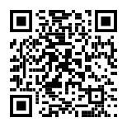
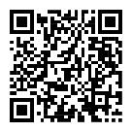
Where to find more information
Resources
Get advice and information in a flood by calling Floodline.
Telephone: 0345 988 1188
Textphone: 0345 602 6340
24-hour service
Sign up for free alerts
Learn how the British Red Cross is ready to help in a crisis
https://www.gov.uk/sign-up-for-flood-warnings
Visit the British Red Cross website to learn more about how to prepare for and cope in a flood.
www.redcross.org.uk/get-help/prepare-for-emergencies/how-to-prepare-for-floods-and-flooding
www.redcross.org.uk/stories/disasters-and-emergencies/uk/how-the-british-red-cross-helps-during-a-flood

Slide 14
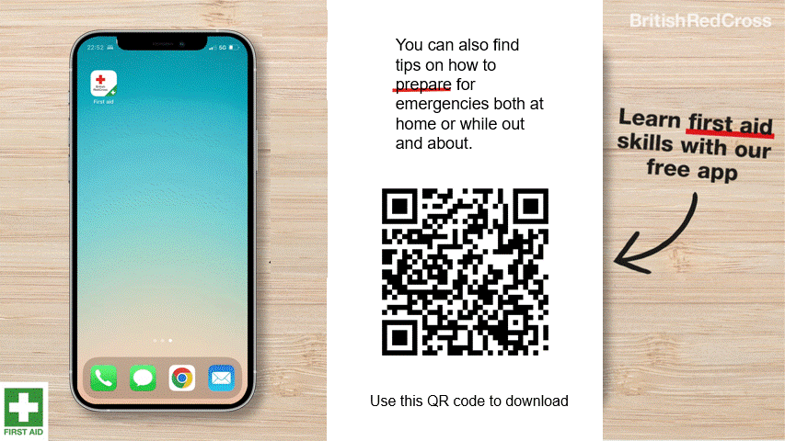
First aid app

Slide 15
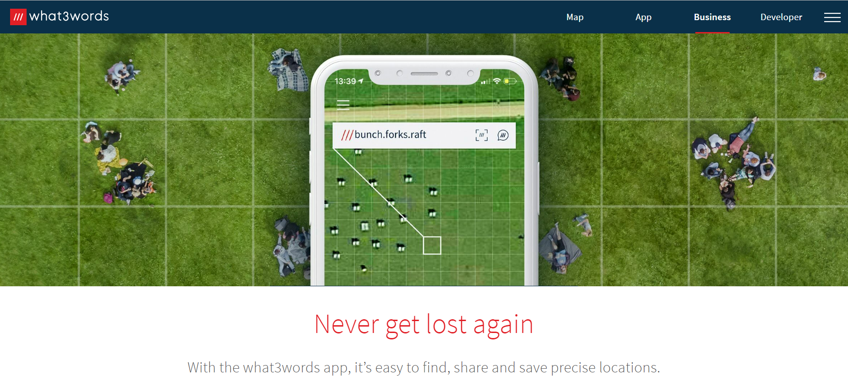
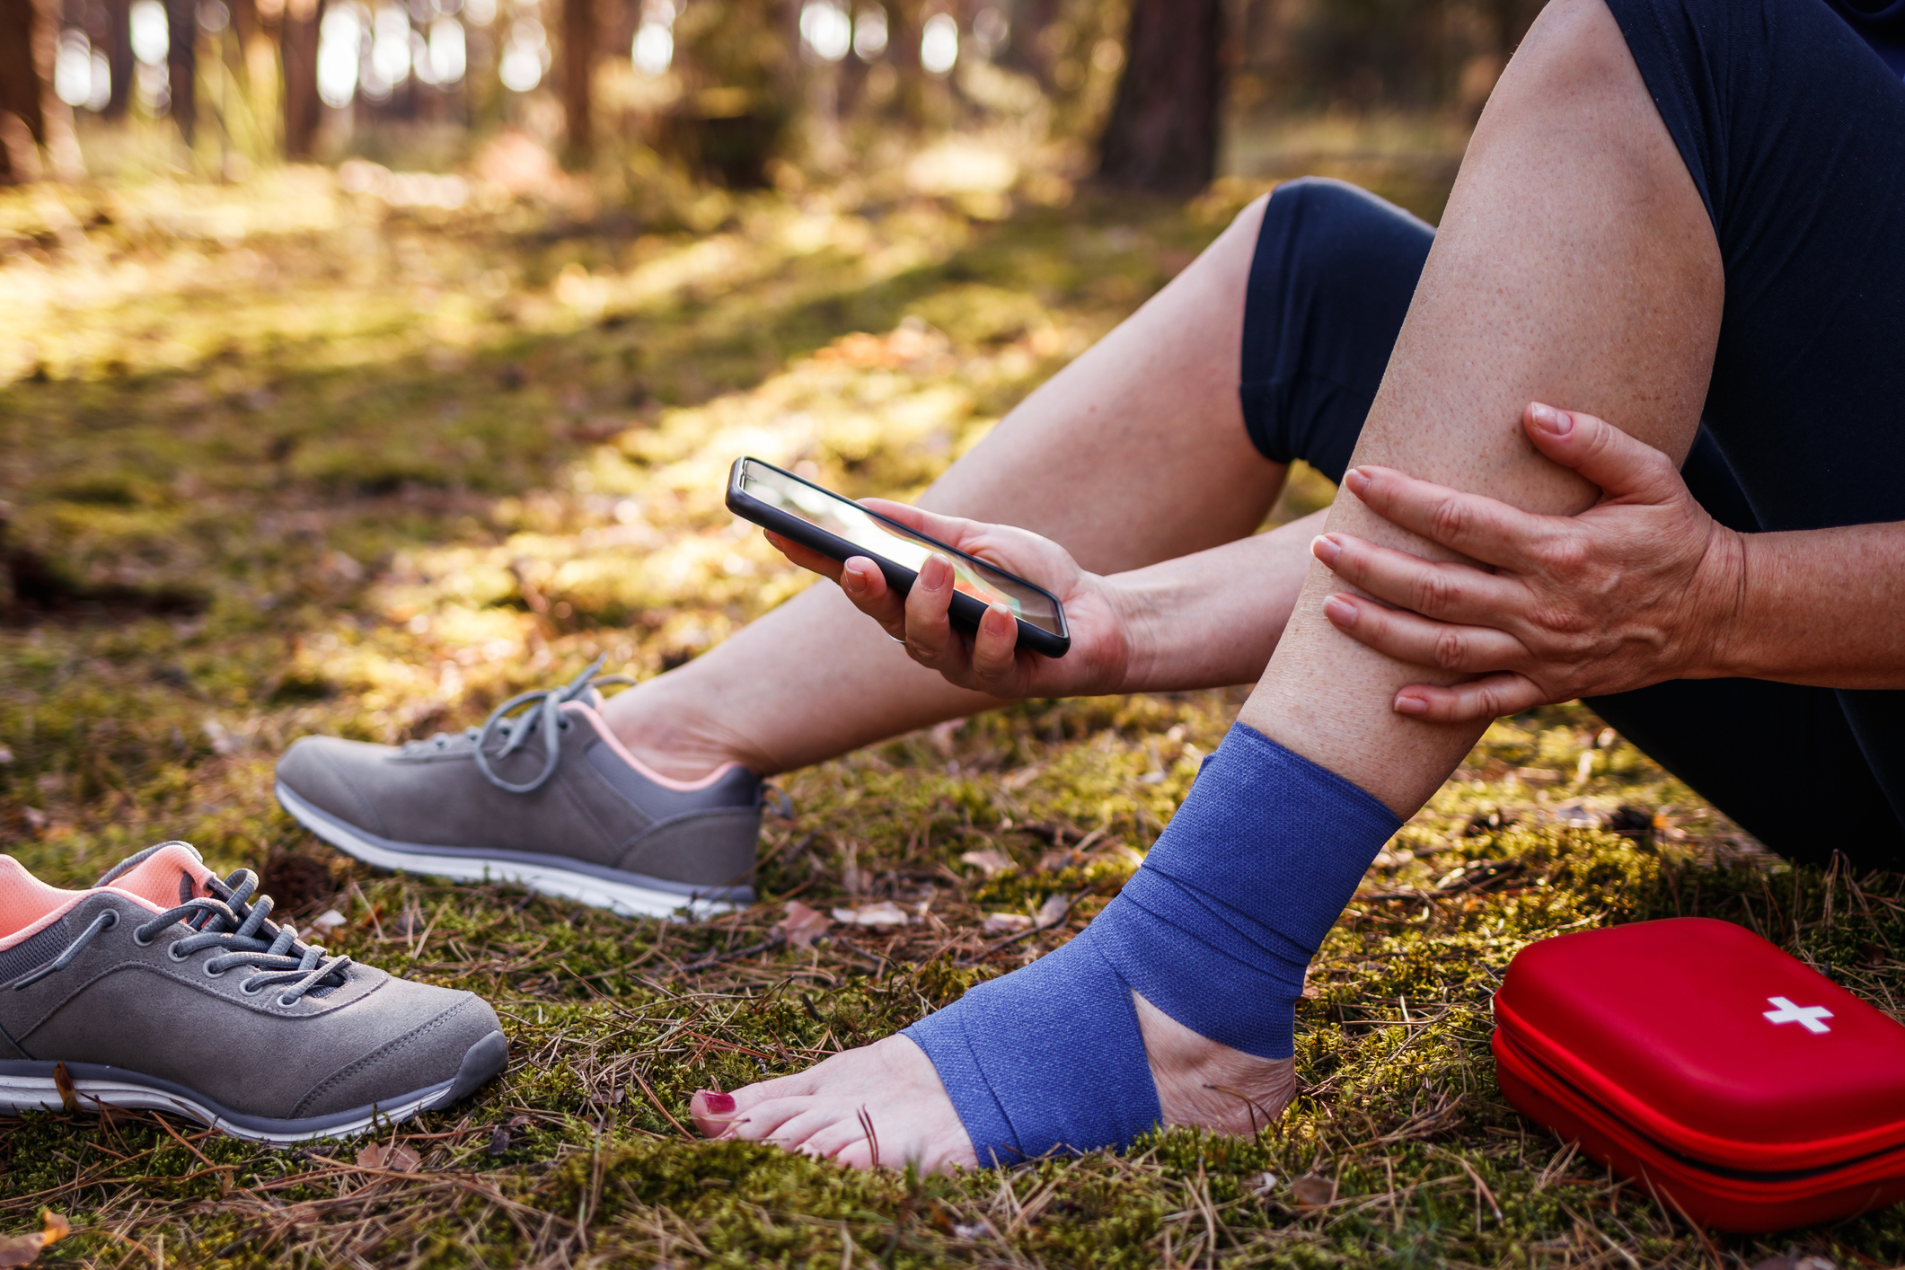
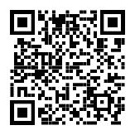
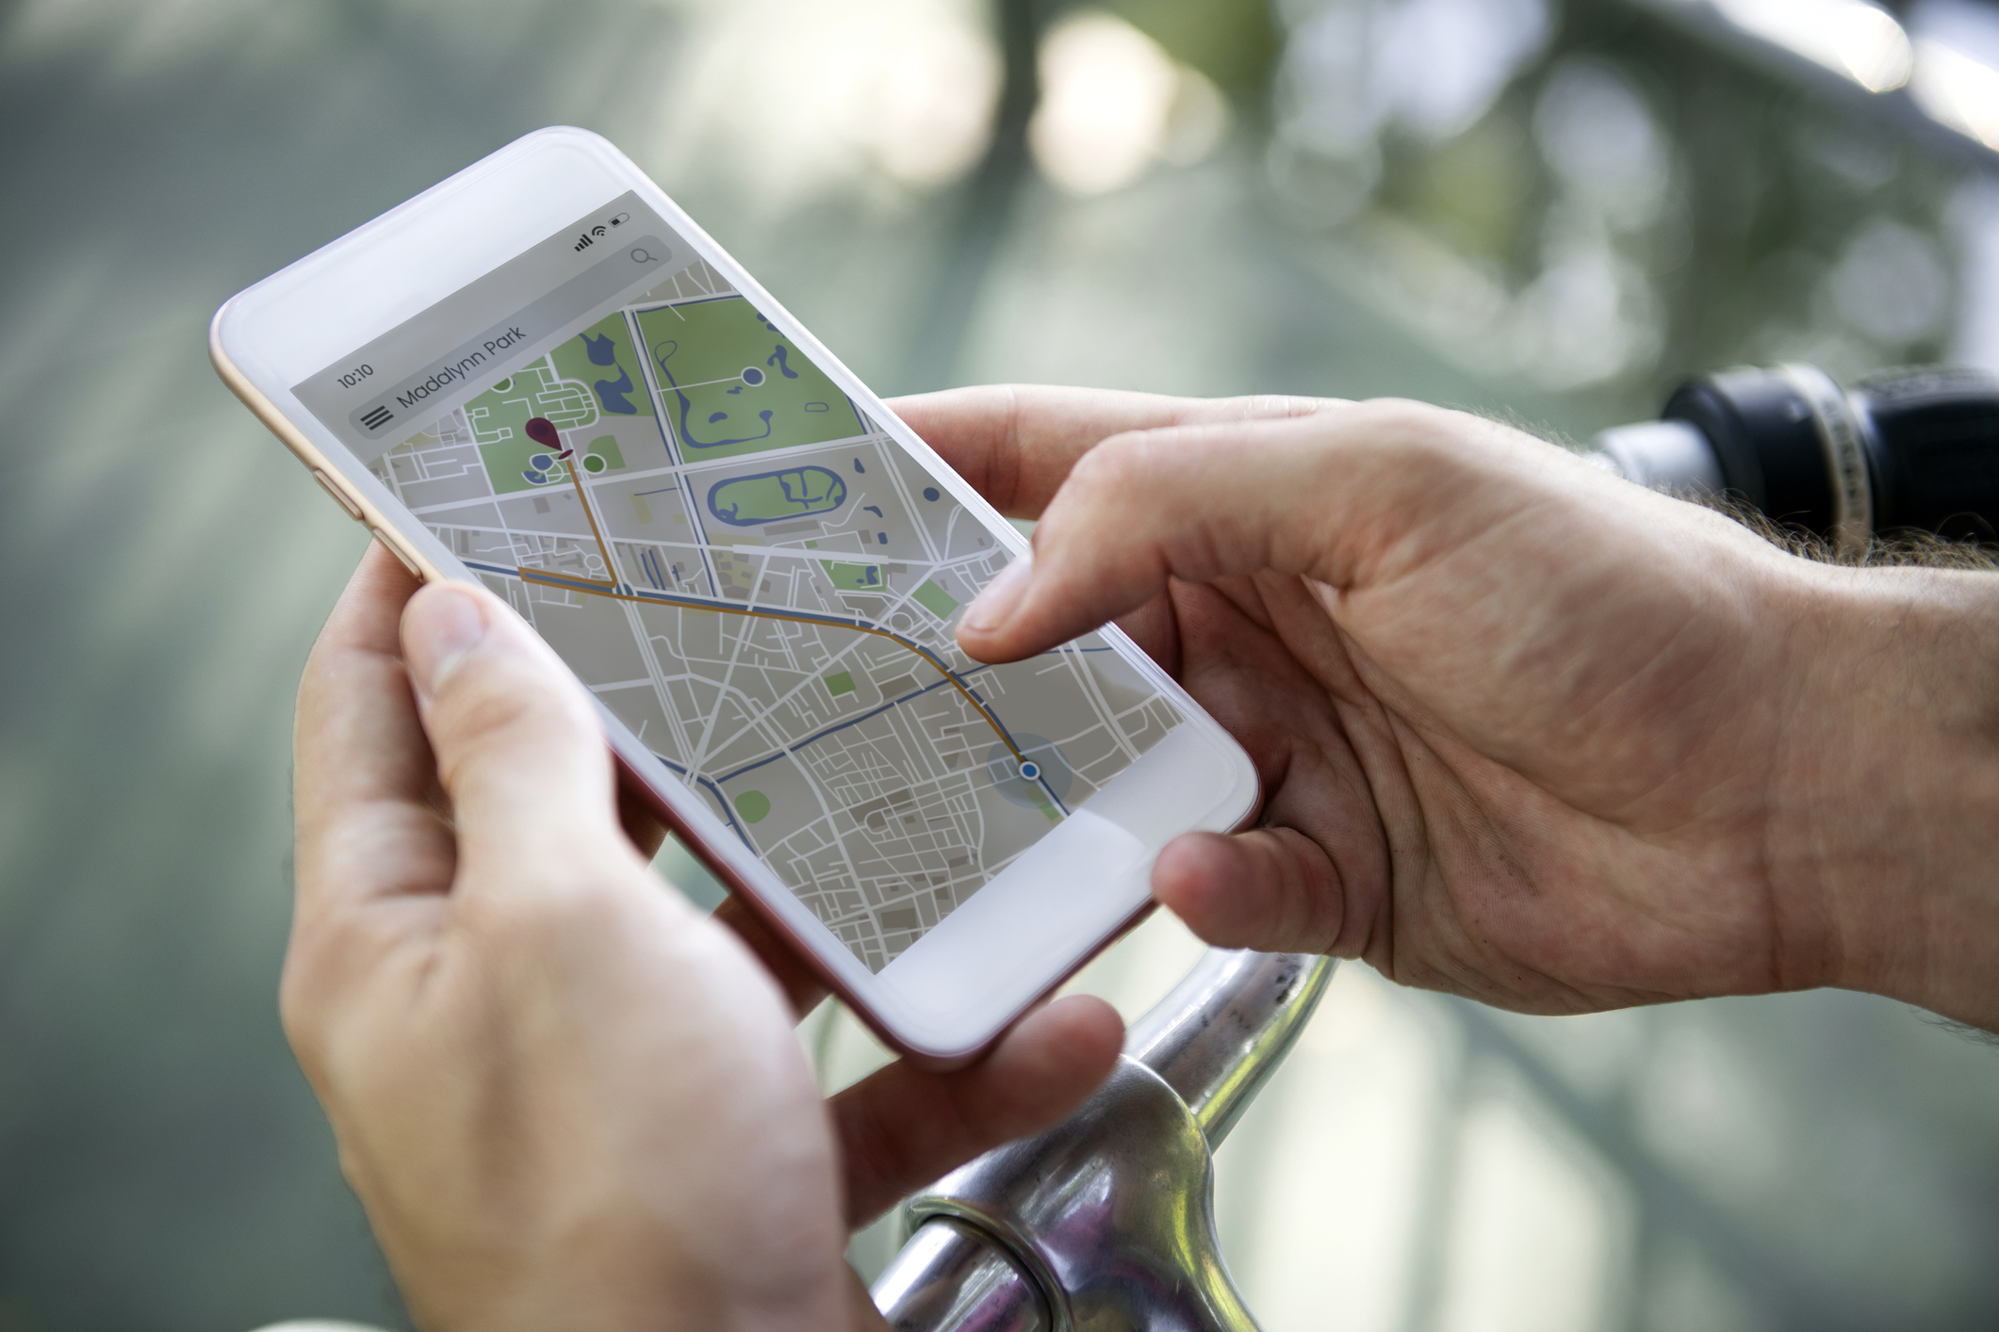
How to tell the emergency services where you are
2. Some smartphones have a built-in feature to call the emergency services and share your location. Find out how to use this on your phone.
3. You could also use a maps app to pinpoint and share your location. Learn how to do this so you’re ready for an emergency.
Resources
1. You could get the what.three.words app
what3words.com/products/what3words-app

Slide 16







Flooding
Heatwaves
Eco-anxiety
Read 3 characters’ flood stories and discuss how they could be affected.
Find out about the effects of heatwaves through completing a quiz.
Worksheet: heatwave facts to print
Read a character’s experience of eco-anxiety and use this to define what it is.
Look at local flood maps and the role of the emergency services to explore how flooding can affect us all.
Worksheet: note writing help
Examine a list of ways to cope and apply this to yourself and others.
Worksheet: coping with eco-anxiety
Learn how heatwaves affects our body and the first aid to help. Apply these to different scenarios.
Poster: heatwaves scenarios
Poster: heatwaves first aid
Create a video/script for social media of how to cope with eco-anxiety to share with friends and family.
Worksheet: eco-anxiety video script
Examine images of flooding and identify the dangers.
Create a decision flowchart to share with friends and family to help them prepare for a heatwave.
Worksheet: decision flowcharts
Play a scenario game to find out about bug out bags and why it is important to have one ready.
For use across all topics
Starters
Plenaries
Weather Together
award tracker
Bronze certificate
Silver certificate
Gold certificate
Play a ‘choose your own adventure’ game to learn how to respond to flood alerts and warnings.
Create resources to share with friends and family. This activity is designed to be repeated.
Rate these resources
Open another activity
Link
Link
Fill in this quick survey to help us improve Weather Together.
Click here to open the full web index.

