Slide 1





Weather Together: Flooding – prepare your home
20 Minutes
Success criteria
Must identify ways to prepare for a flood at home.
Should explain how to respond to a flood alert.
Whole group
Game
Invite learners to take a pause [3].
Introduce the objective and big question [4,5].
Introduce the flood warning adventure game. Prompt learners to write a list of ways to prepare at home as they play the game [6].
Work through the game together as a group. Encourage learners to choose responses collaboratively [6-29].
Then, invite learners to review the list of ways to prepare and cope that they made while they played the game [30].
Refer back to the Big question to review progress [31].
Apply your learning to prepare for and cope with a flood
How to run the activity
What you need
Optional: laptops/tablets
Optional: print slide 29, one between 2 for learners to examine directly.
Divide learners into smaller groups to work through the game. They will need a tablet/laptop for this.
Ask learners to make notes on the Met Office weather warnings guide for yellow, amber and red warnings that they can refer to in the future. Do the same for flood alert, flood warning and severe flood warning.
Ways to adapt
England: PSHE, Language and literacy, Citizenship
Scotland: Health and wellbeing, Literacy
Wales: Health and Wellbeing, Languages, Literacy and Communication
Northern Ireland: Communication, Thinking skills and personal capabilities,
Language and literacy
Curriculum links
The British Red Cross Society © 2022 incorporated by Royal Charter 1908, is a charity registered in England and Wales (220949), Scotland (SC037738) and Isle of Man (0752)
Notes:
As Weather Together is about emergencies, it has the potential to affect learners who have been impacted by trauma in their lives. This trauma may have been related to an emergency event, or it may relate to something else. Careful consideration should be given before deciding to ask learners to share their personal feelings about past or future emergencies or traumas. If a learner brings up personal feelings, you could validate their feelings and then redirect them back to the discussion or activity.
Please always refer to your organisation’s safeguarding policy should you have any concerns about learner wellbeing.

Slide 2

Notes:
This is a screen saver which you could use while settling the group.

Slide 3



This is a three-minute calming activity.
Pause
Choose a colour for positive, relaxed feelings.
  Maybe yellow, for the warming sun and happiness.
Choose a colour for challenging feelings.
  Maybe grey, for feeling tiredness.
Take a deep breath and imagine you’re breathing in the positive colour. Hold it in for a moment.
Then breathe out the challenging colour. Imagine you’re emptying this feeling out of your body.
Repeat a few times.
Take a pause
colour breathing
Notes:
Explain that it can be distressing to listen to other’s experience of the challenges they’re facing, especially if we have similar experiences and challenges. A way of coping with this is to take a pause. Remind learners this is a way of being kind to ourselves which is important. How our body feels matters.
Prompt learners to move through the steps.
You could invite learners to share, if they choose, how they found this breathing activity.​

Slide 4

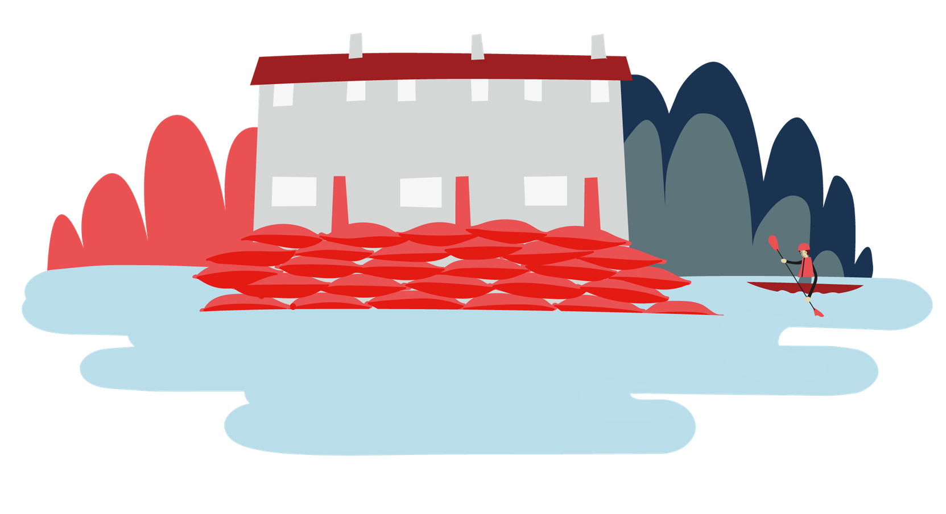

Welcome
Objective: Apply your learning to prepare for and cope with a flood.
To meet this objective, you’ll play the flood warning adventure game and identify all the ways to prepare a home.

Slide 5
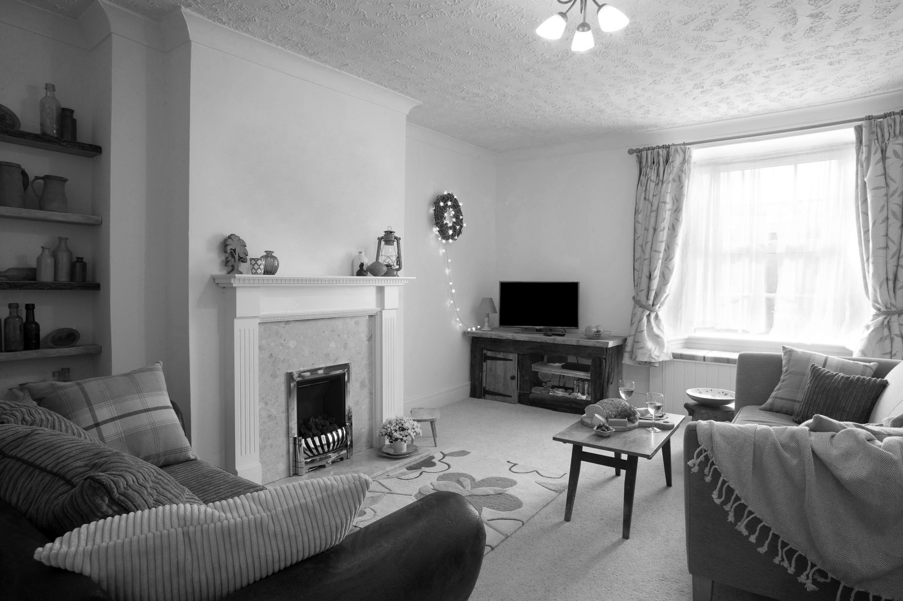

Big question
How can you prepare your home for a flood emergency?
Notes:
Big Questions are an assessment tool for educators and learners to demonstrate progress through an activity.​​
Share this slide with learners and give them a moment to reflect on the question.​​
Then, ask them to discuss with a partner before sharing their ideas with the group.​​
At this point in the activity, it is expected that learners may not have many ideas or know how to answer this question. ​​
The question will be reviewed at the end of the activity. This is an opportunity for learners to see how much progress they’ve made and how many more ideas they now have. ​​
​​

Slide 6

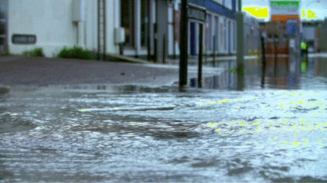
Play the flood warning adventure game
Game
Read the story and choose a response.
As you play the game, you’ll learn about ways to prepare and cope with a flood.
As you play the game, write a list of ways to prepare and cope with flooding.
See if you can find them all!
Notes:
Ensure you are using full-screen view.

Slide 7
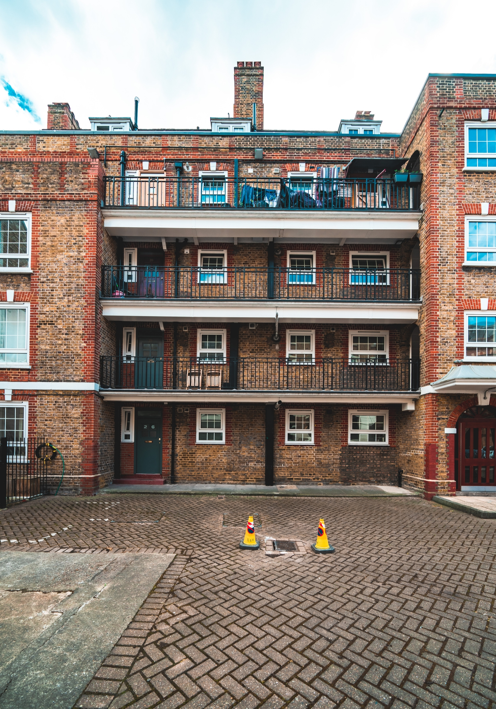


Meet Zara.
Zara lives in a ground floor flat with her dad.
Game

Slide 8



A notification pops up on Zara's tablet saying:
Game
Heavy rains are due for the next 3 days. Flood warnings are in place across the region.
Zara asks her dad what the flood warning means.
Zara uses her tablet to learn about the flood warning.

Slide 9

Game
Zara’s dad isn’t sure either but does feel concerned. He suggests they look online together.

Slide 10

The government’s website has a ‘flood warning’ for their area. So, Zara and her dad research what the three flood warnings mean, together.
Zara’s dad isn’t sure either but does feel concerned. He suggests they look online together.
Continue
Game
Flooding is expected.
Immediate action required.

Slide 11
This is the lowest level of warning. It says fields, land and car parks could be flooded. Minor roads could be affected. Farmland could be flooded. There is likely to be spray and large waves at the coast. Prepare yourself for flooding.
Zara’s dad isn’t sure either but does feel concerned. He suggests they look online together.
Continue
Game
FLOOD ALERT
Flooding is possible.
Be prepared

Slide 12

Flooding of homes and businesses. Railways and roads flooded. Large waves and spray at the coast. Major tourist and recreational locations flooded. Protect yourself and help others.
Zara’s dad isn’t sure either but does feel concerned. He suggests they look online together.
Continue
Game
FLOOD WARNING
Flooding is expected.
Immediate action required.

Slide 13

This is the highest level of warning. Deep and fast flowing water containing debris. Buildings may collapse. Communities isolated by flood waters. Large numbers of evacuees and military support required. Get to a safe space and be ready to evacuate.
Zara’s dad isn’t sure either but does feel concerned. He suggests they look online together.
Continue
Game
SEVERE FLOOD WARNING
Severe flooding.
Danger to life.

Slide 14
The flood warning says people should take action to be prepared for flooding.
She has already put together a bug out bag to grab if they need to leave their house quickly.
After working through the Weather Together toolkit, Zara knows it is important to be prepared for flooding.
Nothing, Zara has her grab bag ready and her dad will sort the rest.
Zara moves valuables to somewhere safe.
She starts thinking about what else they need to do.
What does she do next?

Slide 15

Zara thinks about this some more…
It occurs to her that her dad has a lot of other things on his mind and might need her help..
So she tries to think of what else she needs to do.

Slide 16

Zara moves things around in her room.
The most precious things are moved to the highest places.
She moves everything that is stored on the floor or low down onto shelves, her chair and desk.
Zara decides to scroll through her tablet for a while.
Zara takes photos of each room in her house.
This way, if flood waters come into her house, these things will be safer..
Then, she goes and helps her dad do the same around the flat.
What does she do next?

Slide 17
Zara starts to scroll through her tablet and enjoys the distraction from her worry about the flooding.
But the rain and wind hitting her window means that she can’t stay distracted for long..

Slide 18
Zara knows that it is important to take photos of the house because if it is damaged by flood waters, the photos can be used as evidence of what they had.
Zara checks with her dad, then takes detailed photos of every room.
Zara asks her dad if he knows how to switch off the electricity and gas.
Zara has a snack and drink with her dad.
They can show the photos to the insurance company as proof.
What does she do next?

Slide 19

Zara and her dad take a break and have a drink together.
They were worried at first but are feeling calmer now because they’ve talked, shared their feelings and taken some actions to protect their home.
They talk through how they are feeling.
Zara asks about the electricity and gas supplies.
Zara tries another way of feeling calm.
What does she do next?

Slide 20
Zara tries colour breathing. Zara chooses purple for calmness and red for worry. She takes deep and slow breaths.
When she breathes out, she imagines all the red worry leaving her body.
She feels more able to help her dad again now and asks him about the electricity and gas supplies.
She does this for a few minutes.
When she breathes in, she imagines purple flowing into her body, filling her with calmness.
Then, she notices how her body is feeling.

Slide 21

Zara knows that it is important to switch off the gas and electricity supply to her house in case of flooding..
If gas equipment is flooded it may be unsafe to use.
Zara asks her dad to check he knows how to turn them off.
Zara messages her friend
Zara asks her dad about their car.
Electricity is conducted by water so it could cause an electric shock.
What does she do next?

Slide 22
Zara sends a message to her friend to ask how she’s doing.
Zara asks her if she is doing anything to prepare in case there’s a flood.
Her friend says she’s bored because she doesn't want to go out in the rain and they have to look after her little sister who is annoying.
Zara sends a link to the flood alerts page.
Zara’s friend says they hadn’t seen this but now they’ll go and ask their carer about what they can do.

Slide 23
Zara asks her dad about their car.
Flood waters could damage the car.
Her dad keeps their car in the parking space outside the flat.
So Zara asks her dad to think about moving this if the flooding risk worsens.

Slide 24
Outside the rain is heavy.
Zara looks at the Met Office weather forecast to learn more.
Zara can now relax because her house is prepared.
Zara is still worried about the risk of flooding.
.
What does she do next?

Slide 25
Game
Zara’s dad is still concerned about the flooding and would like some more information so he asks Zara to use the internet to find out more.

Slide 26
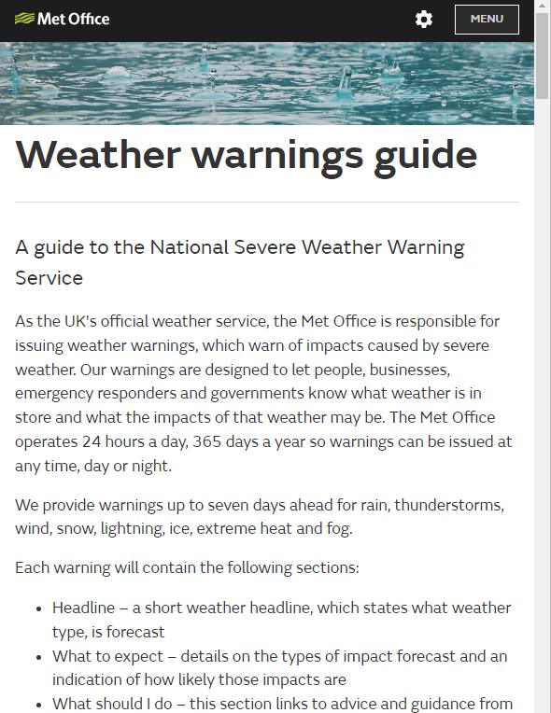
Zara’s dad isn’t sure either but does feel concerned. He suggests they look online together.
Continue
Game
Look at the Met Office’s guide to weather warnings.
The weather forecast has an amber weather warning for rain.
Zara and her dad look at the Met Office to learn about weather warnings.

Slide 27
“You may want to consider the impact of the weather on your family and your community and whether there is anything you need to do ahead of the severe weather to minimise the impact.”
Zara and her dad discuss this and who they might need to help.
Game
Zara goes to see her neighbours who are older people.
Zara messages her neighbours who have a new baby
They think about what the amber weather warning says:
Zara’s dad is concerned about his parents and Zara wants to make sure her neighbours are okay.

Slide 28
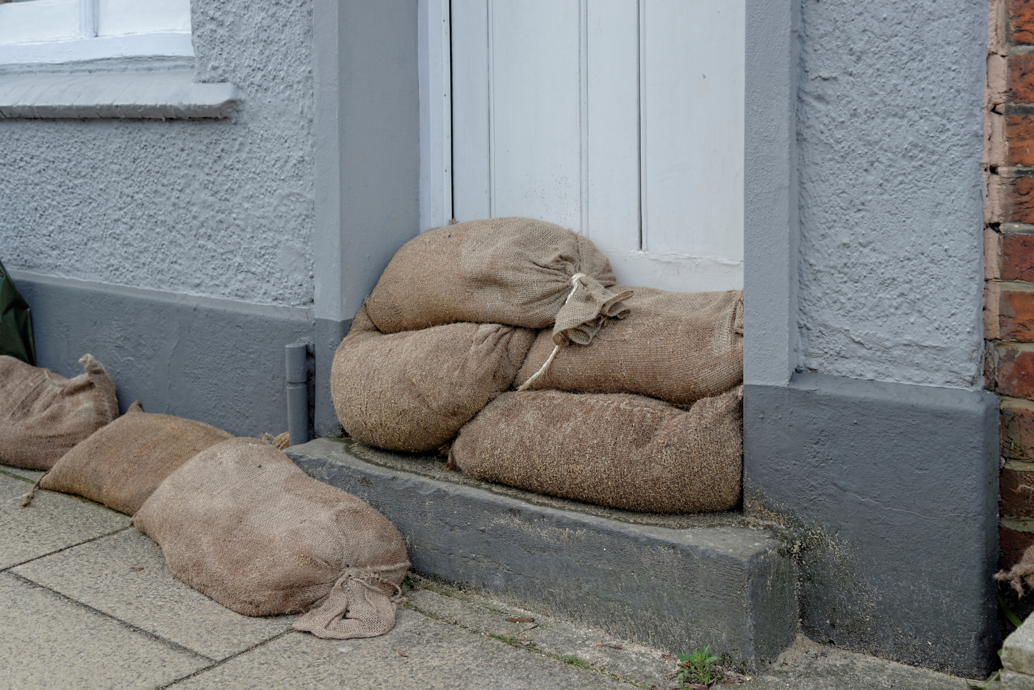
Zara’s neighbours hadn’t seen the flood warning but they have got some emergency food in their cupboards in case they get stuck at home.
They have some sandbags to place in front of their door but they struggle to lift them.
They have candles ready. They are delighted when Zara offers to help them prepare their home.
Zara moves the sandbags to help.

Slide 29
Zara’s neighbours message back.
Zara explains what the warning means and that everyone should be ready.
They had seen the amber warning and flood warning but they aren’t worried because their house has never flooded.
Zara explains some ways the neighbours should prepare their home. Zara says to message if they need anything.

Slide 30
Zara and her dad have prepared their flat and helped the neighbours and family by letting them know about the flood risk.
Finally, they discuss what they will do if flooding affects the roads around their flat and what they’ll do if there’s a power cut.
Zara’s dad has some tins of food and Zara has a torch and candles so they decide they will be okay.

Slide 31
As the rain is torrential (and there are lots of reports of difficulties on the roads) they decide to stay home and avoid going out anywhere.
End.

Slide 32
Did you find them all?
Move items off the floor
Take photos
Ask how to switch off electricity and gas
Ask about moving the car
Have a bug out bag ready
Have some tins of food
Have a torch
Use sandbags
Avoid travelling anywhere
Tell others and help if you can
Game
Look at the list of ways to prepare and cope that you made as you played the game.
Compare your list to ours.
How did you do?
Bug out bag – a bag of items ready to grab in an emergency.

Slide 33
Big question
How can you prepare your home for a flood emergency?
Notes:
Big Questions are an assessment tool for educators and learners to demonstrate progress through an activity.​​
Share this slide with learners and give them a moment to reflect on the question.​​
Then, ask them to discuss with a partner before sharing their ideas with the group.​​
At this point in the activity, it is expected that learners may not have many ideas or know how to answer this question. ​​
The question will be reviewed at the end of the activity. This is an opportunity for learners to see how much progress they’ve made and how many more ideas they now have. ​​
​​

Slide 34

End
Thank you

Slide 35
Resources and support

Slide 36
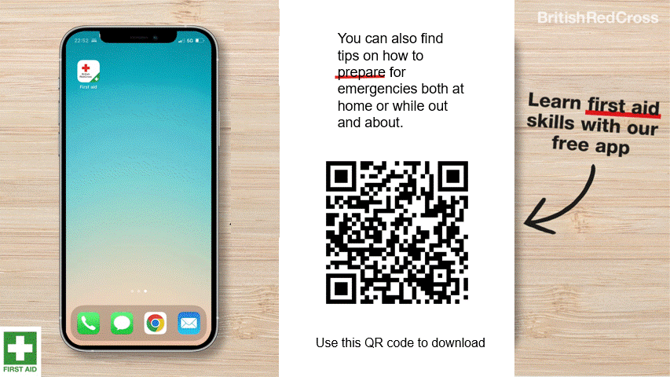
First aid app

Slide 37

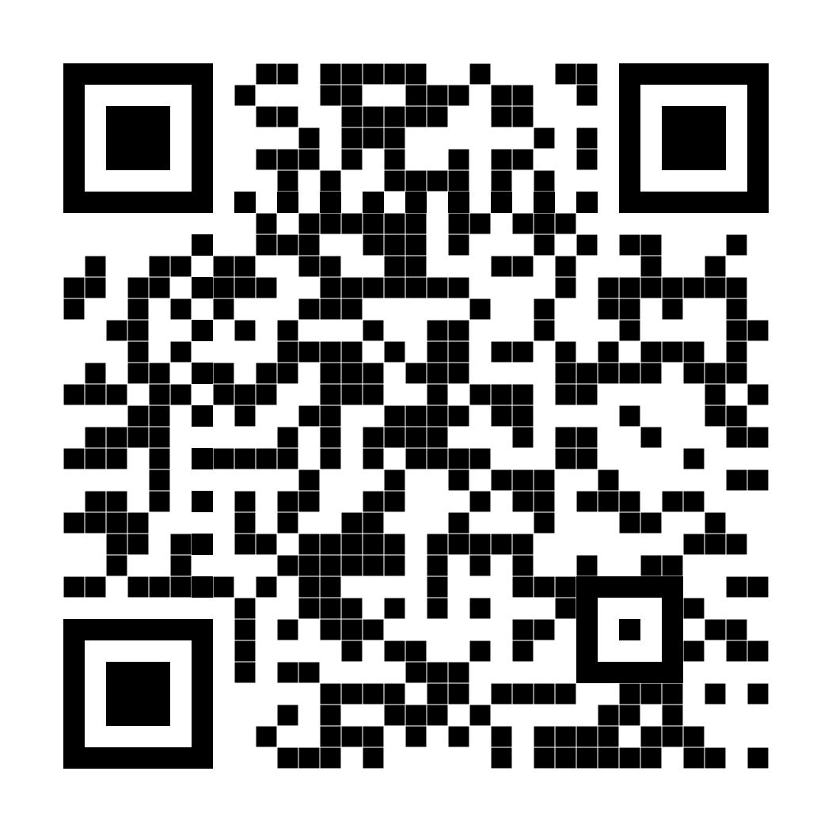
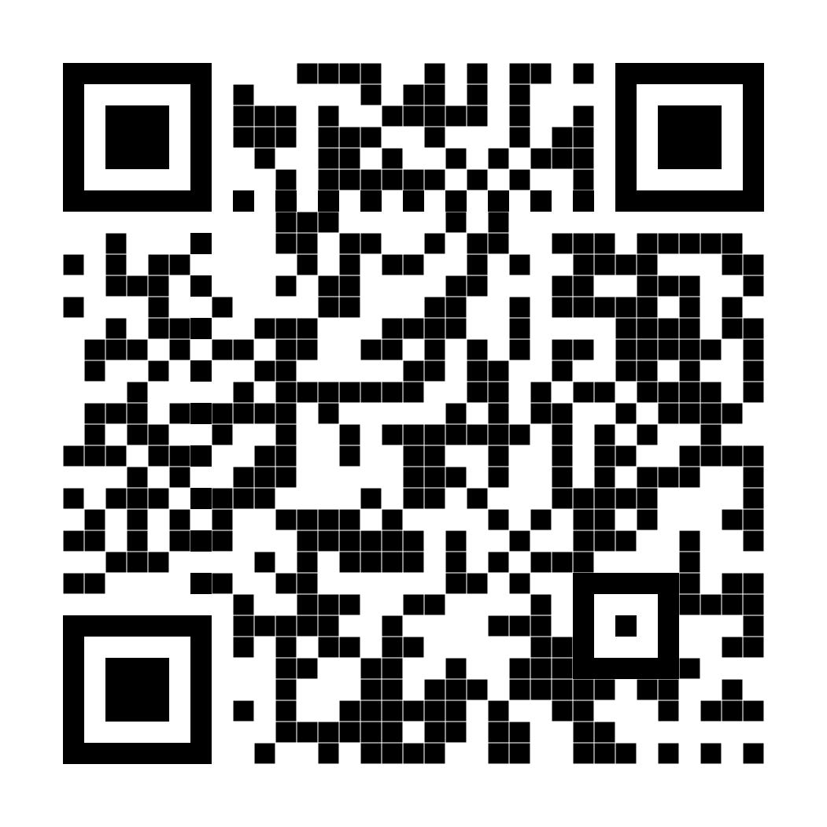
Where to find more information
Resources
Get advice and information in a flood by calling Floodline.
Telephone: 0345 988 1188
Textphone: 0345 602 6340
24-hour service
Sign up for free alerts
https://www.gov.uk/sign-up-for-flood-warnings
Learn how the British Red Cross is ready to help in a crisis
Visit the British Red Cross website to learn more about how to prepare for and cope in a flood.
www.redcross.org.uk/get-help/prepare-for-emergencies/how-to-prepare-for-floods-and-flooding
www.redcross.org.uk/stories/disasters-and-emergencies/uk/how-the-british-red-cross-helps-during-a-flood

Slide 38
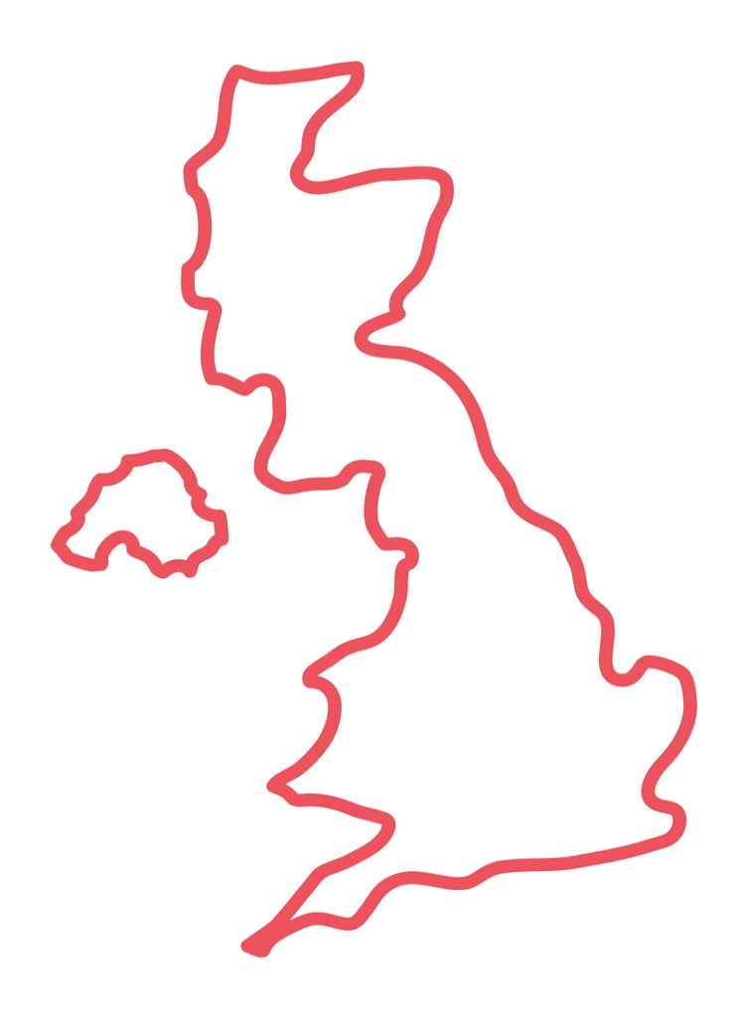
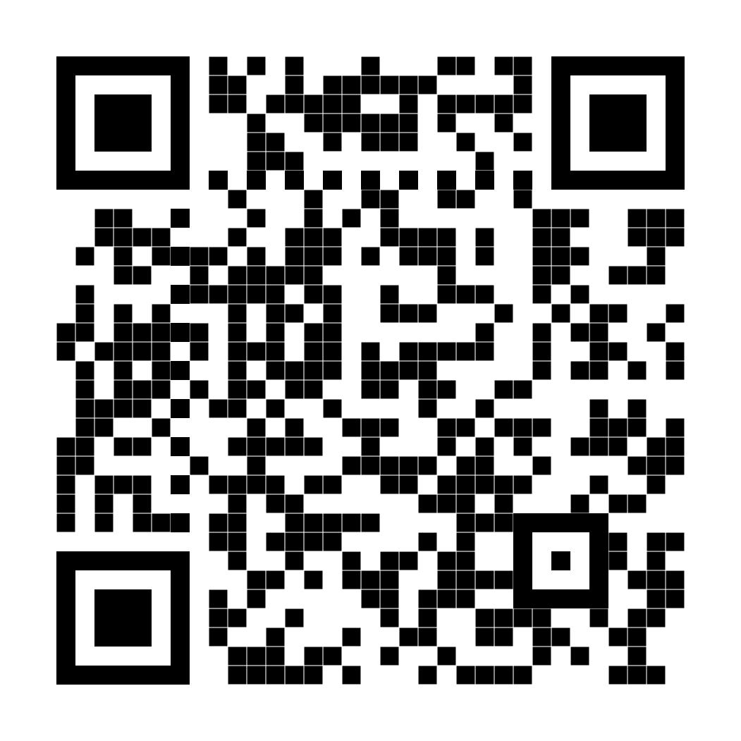
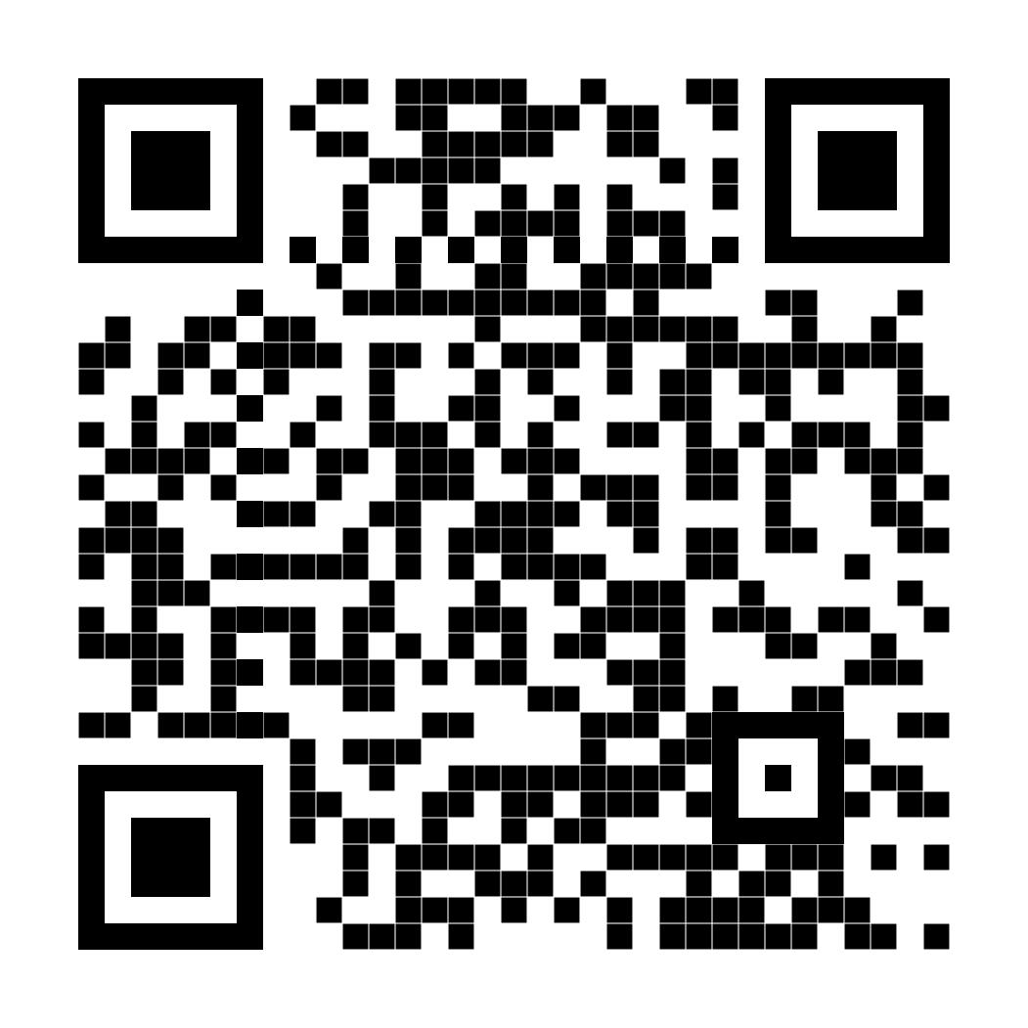

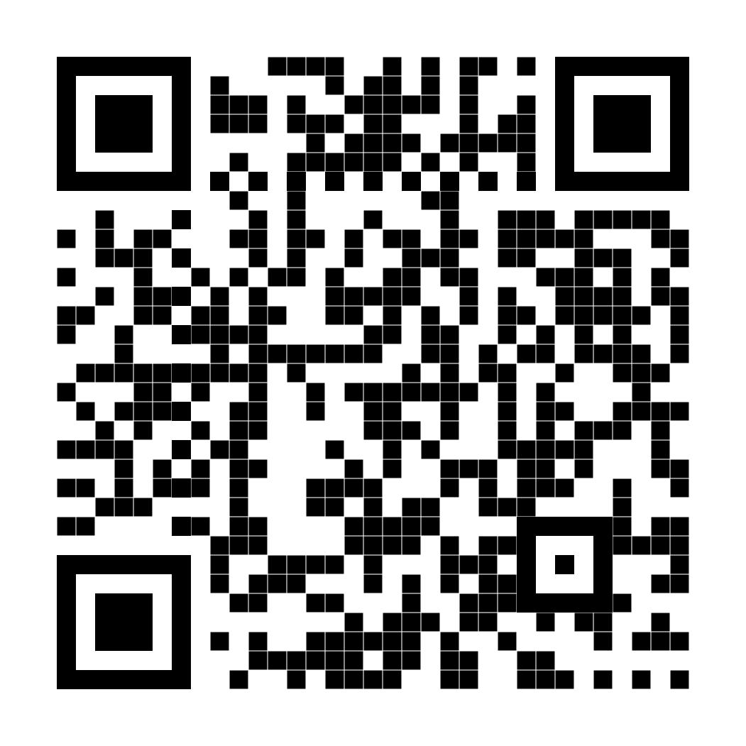

Flood maps in the UK
Visit your nation’s website and examine the maps to learn about flood risks in your area.
Flood maps
Scotland
Northern Ireland
England
Wales
Select for websites

Slide 39

Sources of support
Support
Contact Childline
You can contact Childline about anything. Whatever your worry, it's better out than in. They are here to support you.
You can reach them by:
Call 0800 1111 for free
Have a 1-2-1 chat with a counsellor on their website
Email them by following the instructions on their website
Contact YoungMinds
YoungMinds are the UK’s leading charity fighting for children and young people's mental health.
You can reach them by:
For 24/7 crisis support you can text YM to 8525
Find out about CAMHS, who's who in mental health services and who you can call if you need to talk to someone at their website
Contact Samaritans
Samaritans is not only for the moment of crisis, they are taking action to prevent the crisis.
You can reach them by:
Call them for free, 24/7 on 116 123
Email them: jo@samaritans.org
Notes:
Use this slide to signpost learners on to further support for challenges they may be facing and need help.

Slide 40
Find other Weather Together activities
Click the links below to go to each activity in the toolkit
Activities
Flooding
Flooding can affect anyone - Learn
Investigate flood risk near you - Learn Worksheet: Note writing help
The dangers of flooding - Learn
Why grab bags save lives - Apply
Prepare your home for a flood - Apply
Help others to prepare - Share
Heatwaves
Heatwave quiz - Learn
Heatwave safety - Apply
Heatwave decision tree - Share Worksheets: Decision tree option 1, option 2, option 3
Use across all topics
Starters
Plenaries
Weather Together award tracker
Bronze certificate
Silver certificate
Gold certificate
Eco-anxiety
What is eco-anxiety - Learn
Ways to cope – Apply
Help others to cope - Share

Slide 41
© British Red Cross 2023. All images © British Red Cross 2023 unless otherwise stated, below.
This resource and other free educational materials are available at www.redcross.org.uk/education
The British Red Cross Society is a charity registered in England and Wales (220949) and Scotland (SCO37738).
Slide: UK flood maps United Kingdom Editable Outline Map Vector Illustration High-Res Vector Graphic - Getty Images Credit: Ivan Burchak Creative #: 1410395631 Collection: iStock | Slide: Zara and her dad look online Looking At Family Album On Smart Phone High-Res Stock Photo - Getty Images Credit: Pekic Creative #: 959391208 Collection: E+ | Slide: game background Slow Motion Sequence Of Wellington Boots Walking Along Flooded Road High-Res Stock Video Footage - Getty Images Credit: monkeybusinessimages Creative #: 458534402 Collection: Creatas Video+ | Slide: Zara Teenage Muslim Student Girl Studying At Home High-Res Stock Photo - Getty Images Credit: Barcin Creative #: 625749690 Collection: E+ | Slide: Zara’s flat Old Council Tower Block In London Uk High-Res Stock Photo - Getty Images Credit: CHUNYIP WONG Creative #: 1397236966 Collection: iStock
Slide: phone message Copy Space Smartphone High-Res Stock Photo - Getty Images Credit: PhoThoughts Creative #: 1025617586 Collection: iStock | Slide: Zara scrolls through her tablet Rain Drop On Glass With Blue Turquoise Background High-Res Stock Video Footage - Getty Images Credit: thaiview Creative #: 1398849904 Collection: Creatas Video | Slide: Zara and her dad have a break Closeup Shot Of An Unrecognisable Couple Drinking Coffee While Relaxing Together At Home High-Res Stock Photo - Getty Images Credit: jeffbergen Creative #: 1340768665 Collection: E+ | Slide: sandbags at parents’ house Sandbags Outside Front Door Of House To Prevent Flooding High-Res Stock Photo - Getty Images Credit: AlexMcGuffie Creative #: 470279997 Collection: iStock | Slide: big question Empty Living Room High-Res Stock Photo - Getty Images Credit: DGLimages Creative #: 868510546 Collection: iStock
Media credits

