Slide 1





Instructions
Weather Together – Heatwaves : help others cope
30 Minutes
Success
criteria
Must create a resource to help someone prepare for a heatwave.
Could share your resource with people in your community.
Independent
Creative
Invite learners to take a pause [3].
Introduce the session and the big question [4,5].
Let learners know that they will create a decision flowchart to help share information about how to prepare and cope with a heatwave with friends and family [6]. Look at an example of a completed decision tree together [7]. Explain to learners that there are 3 options to choose from to create their decision trees [8].
Explain/recap the Weather Together award and progress trackers [9-11].
Encourage learners to reflect and decide how they will take action from today's session [12].
Refer back to the big question to review progress [13].
Share your learning to help others prepare and cope.
How to run the activity
What you need
Print outs of the decision flowchart templates for learners to choose from.
You may prefer to allocate learners a decision tree to create, rather than having learners choose.
Use laptops/tablets/a computer suite for this activity to enable learners to design their resource digitally. If you think it appropriate, learners could share/save a copy of their work to take home.
Provide peer support by asking learners to work together to create one decision tree in a pair. One learner could be a researcher and the other a writer.
Ways to adapt
Curriculum links
England: PSHE, Language and literacy, Citizenship
Scotland: Health and wellbeing, Literacy
Wales: Health and Wellbeing, Languages, Literacy and Communication
Northern Ireland: Communication, Thinking skills and personal capabilities,
Language and literacy
The British Red Cross Society © 2023 incorporated by Royal Charter 1908, is a charity registered in England and Wales (220949), Scotland (SC037738) and Isle of Man (0752)

Slide 2

Screensaver
Notes:
This is a screen saver which you could use while settling the group.

Slide 3




Take a pause
Flame focus
Pause
This activity can help you to find calm and stillness when you’re feeling overwhelmed or hectic.
Sit up straight with your feet flat on the ground and your hands resting in your lap.
Take a few slow, deep breaths.
Focus your eyes on the candle, noticing its movements for 1 minute. When thoughts pop into your head, just notice them and let them go again.
Take a pause
happy place
Notes:
If you have a brightly lit classroom, this would be a good opportunity to dim the lights and close the blinds.
You can explain that it can be distressing to listen to other’s experience of the challenges they’re facing, especially if we have similar experiences and challenges. A way of coping with this is to take a pause. Remind learners this is a way of being kind to ourselves which is important. How our body feels matters.
Prompt learners to move through the steps.
Invite learners to share how they’re feeling after the activity, if they would like to.

Slide 4

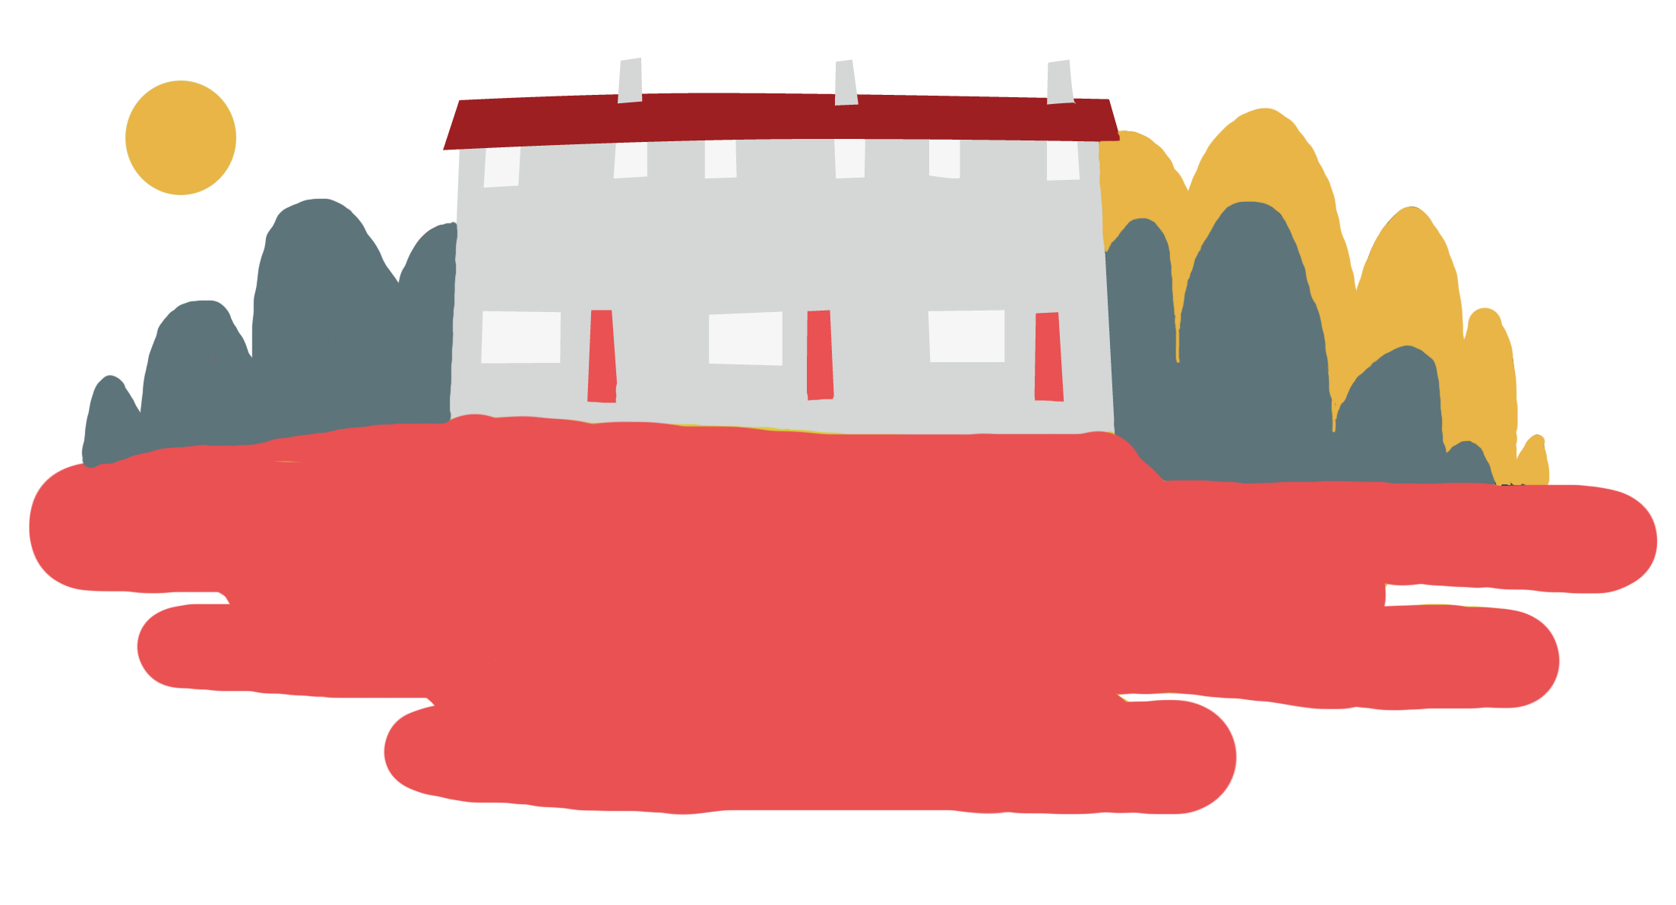

Objective
Heatwaves
Objective: Share your learning to help others prepare and cope.
To meet this objective, you’ll create a decision tree to help someone decide whether they’re ready for heatwaves and encourage them to be prepared.
Earn points for sharing your resource at home!

Slide 5
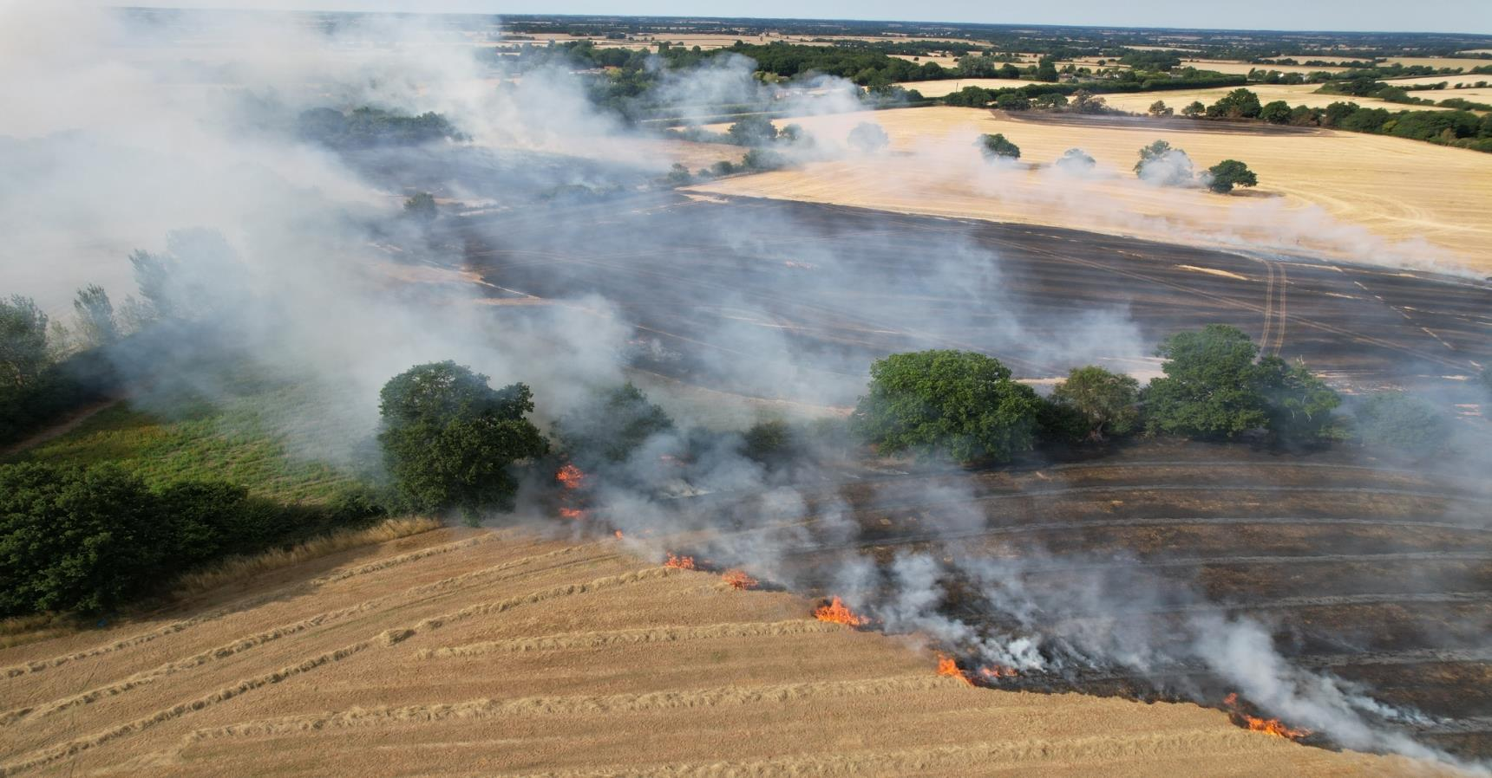

Big question
Big question
Why is it important to share ways to prepare and cope with a heatwave with the people you know?
Notes:
Big questions are an assessment tool for educators and learners to demonstrate progress through an activity.
Share this slide with learners and give them a moment to reflect on the question.
Then, ask them to discuss with a partner before sharing their ideas with the group.
At this point in the activity, it is expected that learners may not have many ideas or know how to answer this question.
The question will be reviewed at the end of the activity. This is an opportunity for learners to see how much progress they’ve made and how many more ideas they now have.

Slide 6

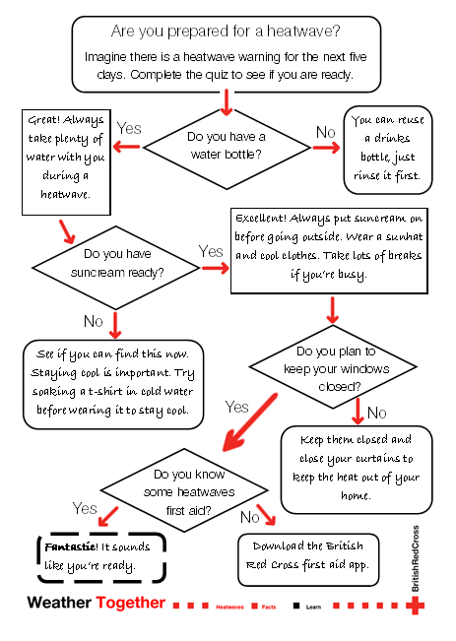
Heatwaves decision flowchart
A decision flowchart is a tool to help guide you to make choices based on possible scenarios or outcomes.
Your challenge is to create a decision flowchart to help someone decide whether they are ready for a heatwave and decide what action they should take.
Then you can share your decision flowchart with people you know to help them prepare.
Notes:
Introduce decision flowcharts to learners as it is likely they’ve never heard of these before.
You could ask learners if they’ve ever seen these in magazines and build on their understanding that way.
But if they haven’t, we have provided an example on slide 6 for support.

Slide 7
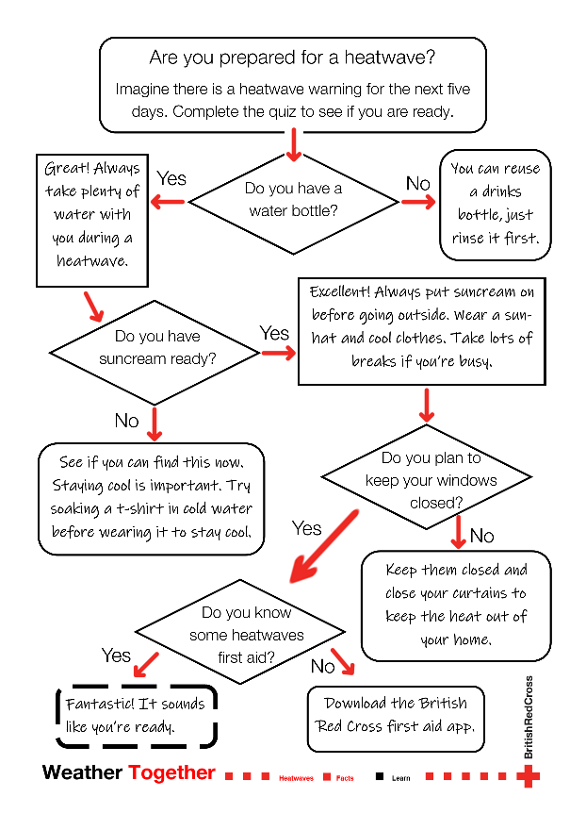
How to make a heatwaves decision flowchart
Have a look at this example together.
Is there anything else you would ask or include?
Notes:
Model how to use a decision flowchart, working through the example together as a class.
Ask learners if there are any other questions to ask that would help people prepare for heatwaves. Prompt them to think about sleep during heatwaves, what to do if they’re very busy, what is better to eat and drink and how to keep up to date with the heatwave situation.
Discuss the kinds of responses they could give to questions about these things.
You may prefer to invite learners to work together with come up with ideas about what they will include before completing the activity.

Slide 8
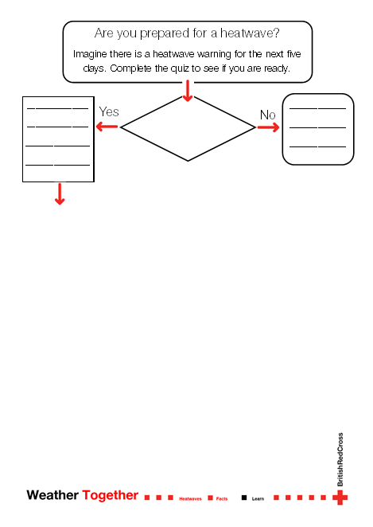
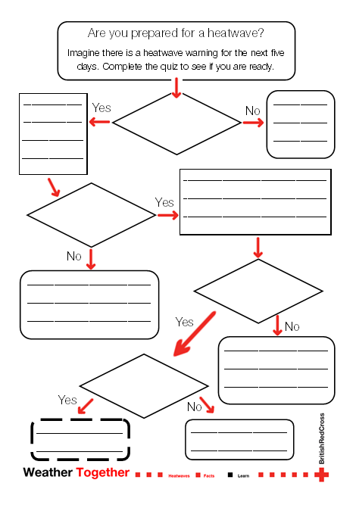
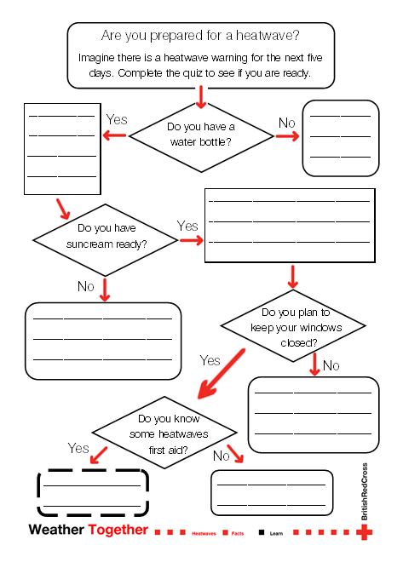
Heatwaves decision flowchart - options
Option 1:
create your own
Option 2:
use the outline to add your own ideas
Option 3:
add your ideas to complete the decision tree
Notes:
Have print outs of each option for learners to choose from.

Slide 9
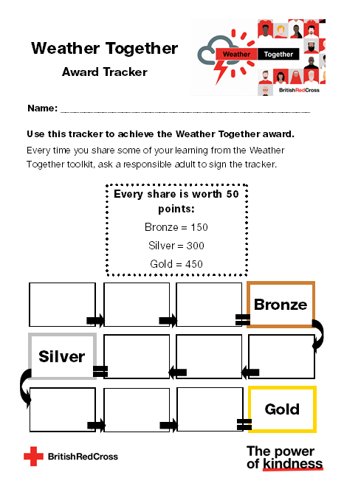
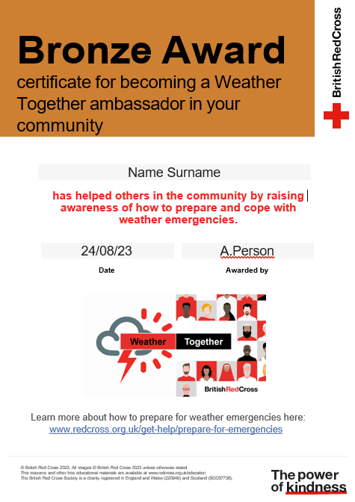
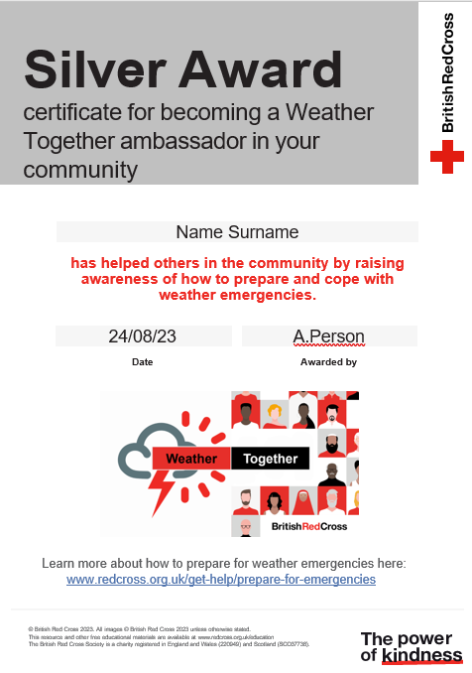
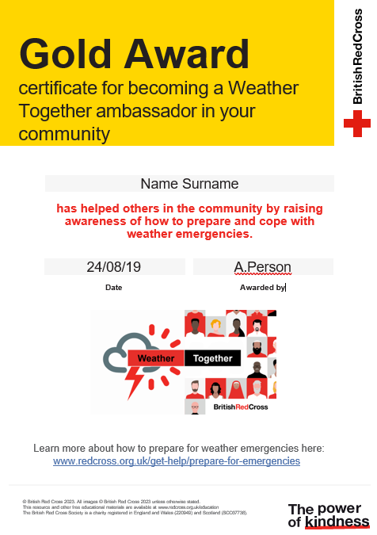
Achieve the Weather Together award
Award
By sharing ways to prepare for and cope with extreme weather, you can become a Weather Together ambassador
Every time you share, earn 50 points.
Use the Weather Together award tracker to keep a record of your points. Ask a responsible adult to sign the tracker each time you share some advice.
Notes:
Use this as homework. A way for learners to take their learning beyond the classroom.
You may need to encourage older learners to engage by explaining this can be used to support applications. It is a way of showing learners they have supported their community.

Slide 10
Achieve the Weather Together Award
Achieve the Weather Together award
Certificates

Slide 11
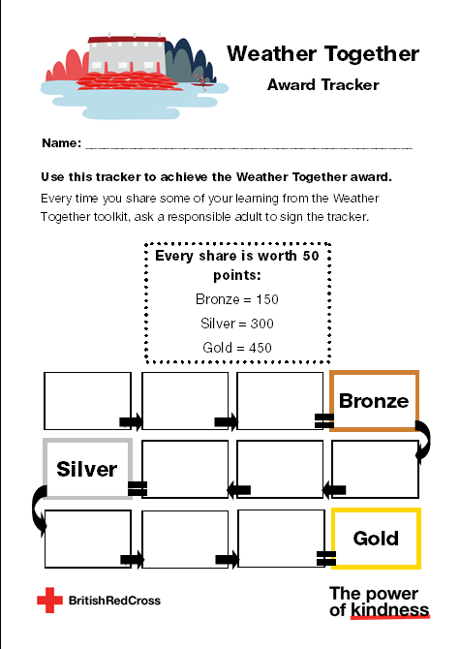
Weather Together award – how’s it going?
Review
If you’ve already made a start at working towards the award, take a moment to review how it’s going.
  How have you shared information?
  What worked?
  What are you pleased with?
  Is there anything you’d change for next time?
  How is your progress towards the next certificate?

Slide 12




Take a moment to reflect
Reflect
First, decide what you will do today to help yourself.
Next, decide how you will earn points and help others by sharing your work.
Then, share your ideas with the group.
Notes:
Ask learners to think of 1 example of something they will do for themselves and others and discuss this with a partner before sharing with the group.

Slide 13
Big question
Big question
Why is it important to share ways to prepare and cope with a heatwave with the people you know?
Notes:
Give learners a few moments to reflect on this question before inviting them to discuss with a partner. Then, encourage feedback as a group.​
Referring back to the big question should enable you and your learners to see how much they have learned from the activity. Answers to this question should be more detailed and varied at this point.​
​

Slide 14

Thank you
End
Thank you

Slide 15
Resources and support

Slide 16
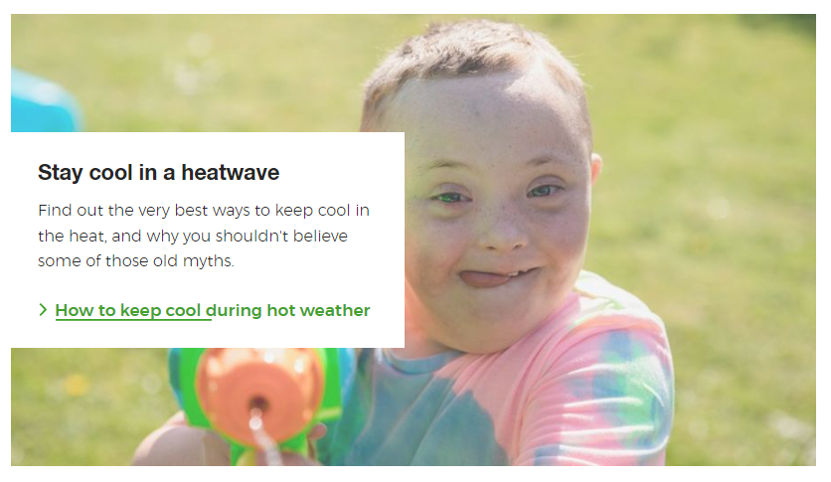


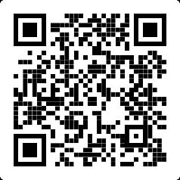
Where to find more information
Learn how to stay cool in hot weather.
Visit the British Red Cross website to read the Feeling the Heat report.
Resources
https://www.redcross.org.uk/stories/health-and-social-care/first-aid/beat-the-hot-weather-top-tips-for-staying-cool
Visit the British Red Cross website to learn more about how to prepare for and cope with heatwaves.
https://www.redcross.org.uk/get-help/prepare-for-emergencies/heatwaves-uk
https://www.redcross.org.uk/about-us/what-we-do/we-speak-up-for-change/feeling-the-heat-a-british-red-cross-briefing-on-heatwaves-in-the-uk

Slide 17
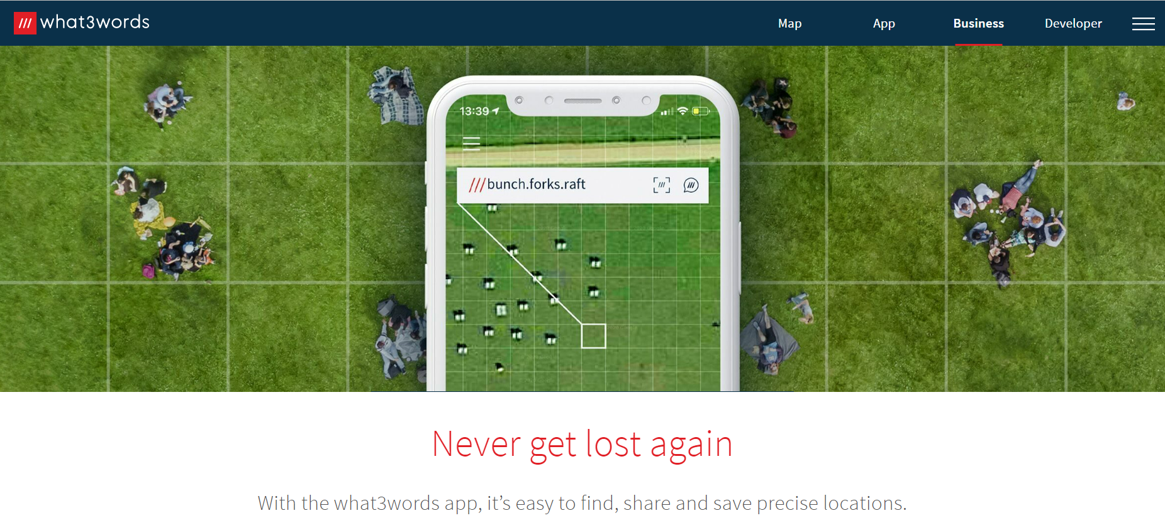
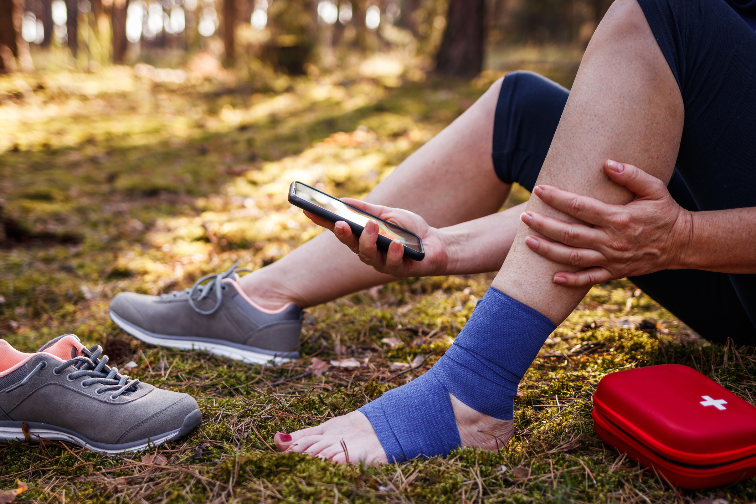
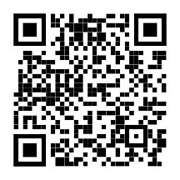
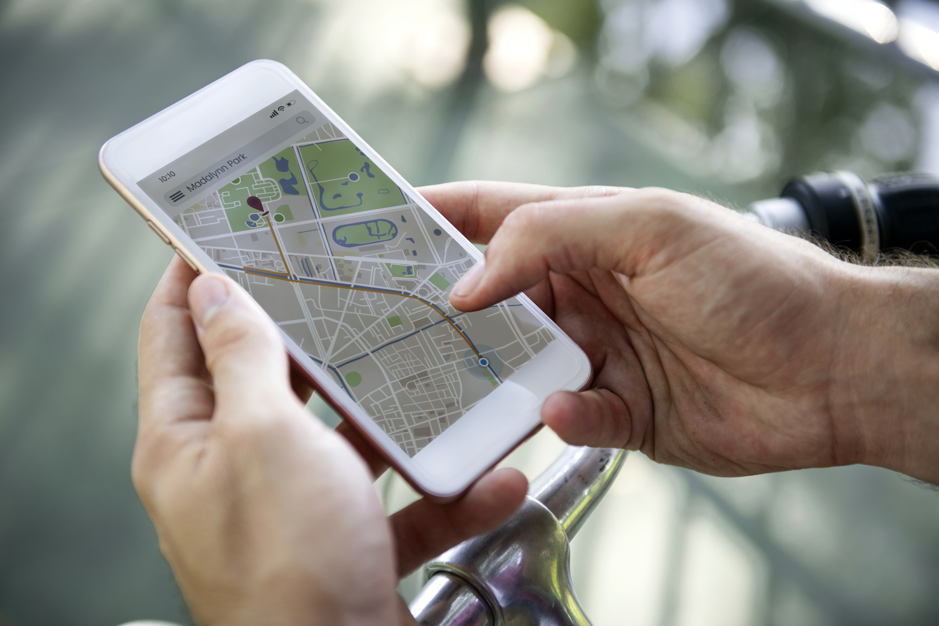
How to tell the emergency services where you are
2. Some smartphones have a built-in feature to call the emergency services and share your location. Find out how to use this on your phone.
3. You could also use a maps app to pinpoint and share your location. Learn how to do this so you’re ready for an emergency.
Resources
1. You could get the what.three.words app
what3words.com/products/what3words-app

Slide 18
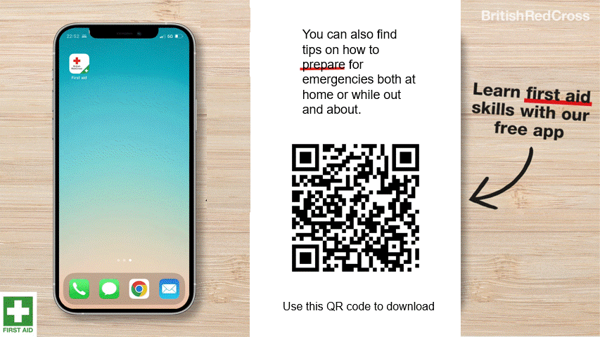
First aid app information
First aid app

Slide 19







Flooding
Heatwaves
Eco-anxiety
Read 3 characters’ flood stories and discuss how they could be affected.
Find out about the effects of heatwaves through completing a quiz.
Worksheet: heatwave facts to print
Read a character’s experience of eco-anxiety and use this to define what it is.
Look at local flood maps and the role of the emergency services to explore how flooding can affect us all.
Worksheet: note writing help
Examine a list of ways to cope and apply this to yourself and others.
Worksheet: coping with eco-anxiety
Learn how heatwaves affects our body and the first aid to help. Apply these to different scenarios.
Poster: heatwaves scenarios
Poster: heatwaves first aid
Create a video/script for social media of how to cope with eco-anxiety to share with friends and family.
Worksheet: eco-anxiety video script
Examine images of flooding and identify the dangers.
Create a decision flowchart to share with friends and family to help them prepare for a heatwave.
Worksheet: decision flowcharts
Play a scenario game to find out about bug out bags and why it is important to have one ready.
For use across all topics
Starters
Plenaries
Weather Together
award tracker
Bronze certificate
Silver certificate
Gold certificate
Play a ‘choose your own adventure’ game to learn how to respond to flood alerts and warnings.
Create resources to share with friends and family. This activity is designed to be repeated.
Rate these resources
Open another activity
Link
Link
Fill in this quick survey to help us improve Weather Together.
Click here to open the full web index.

