Slide 1
East Africa facing hunger
Migration: Channel crossings
Full lesson plan from redcross.org.uk/education
Full lesson plan from redcross.org.uk/education
Notes:
1

Slide 2
“You have to understand no one puts their children in a boat unless the water is safer than the land.”
            from “Home”, by Somali–British poet Warsan Shire

Slide 3
Role Play activity

Slide 4
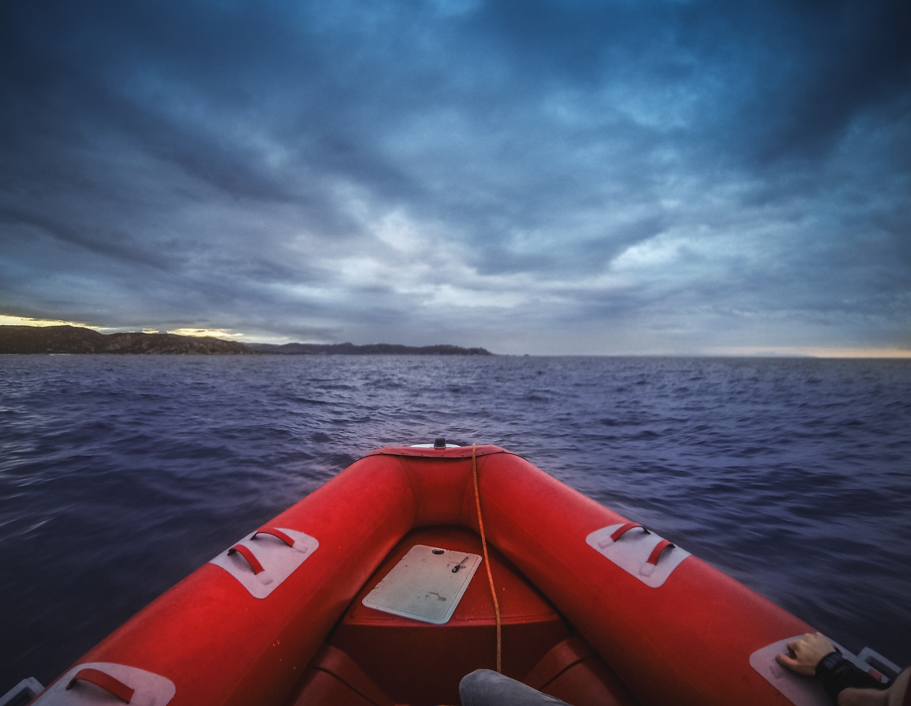

Slide 5
Migration in context: Quiz
How much do you know about refugees?

Slide 6
What is a refugee?
A refugee is someone who moves to another country illegally
A refugee is someone who has proven that they are at risk in their home country and has been legally allowed to live in another country
A refugee is anyone who leaves their home without knowing where they will go to live

Slide 7
What is a refugee?
ANSWER: 2.
A refugee is someone who has proven that they are at risk in their home country and has been legally allowed to live in another country.
Anyone who is trying to claim refugee status is an asylum seeker.

Slide 8
What is a migrant?
Someone who moves from one country to another.
Someone who moves to another country illegally.
Someone who is awaiting legal status to work in a country.

Slide 9
What is a migrant?
ANSWER: 1.
A migrant is someone who has moved to another country, often to find work or better living conditions.
They may or may not have legal status to be in that country.

Slide 10
How many refugees are there around the world?
99.6 million
2 million
25.4 million

Slide 11
How many refugees are there around the world?
ANSWER: 3.
There are 25.4 million refugees around the world according to the United Nations (in June 2018).
The UN estimates that there are 68.5 million displaced people including many who have been forced to leave home but are still in their home countries

Slide 12
Which country is home to the most refugees?
The United Kingdom
Germany
Turkey

Slide 13
Which country is home to the most refugees?
ANSWER: 3.
Turkey hosts 3.5 million refugees, mainly fleeing the conflict in Syria.

Slide 14
How many refugees are there in the UK?
2.1 million
121,000
21,000

Slide 15
How many refugees are there in the UK?
ANSWER: 2.
At the end of 2017 there were over 121,000 refugees in the UK, which is about 3% of the total in Turkey.

Slide 16
Only one of these statements is true; which one?
85% of refugees live in developing countries
50% of all refugees live in Europe
The UK has the most asylum applicants in Europe.

Slide 17
Only one of these statements is true; which one?
ANSWER: 1.
85% of refugees live in developing countries.
Germany has the highest number of asylum applicants in Europe, with the UK having fewer than France, Greece and Spain according to the most recent figures

Slide 18
Photo credits
Slide 4: The image of a boat in the sea approaching land © piola666/iStock.
This resource and other free educational materials are available at redcross.org.uk/education
The British Red Cross Society is a charity registered in England and Wales (220949) and Scotland (SCO37738).
Notes:
1

