Slide 1


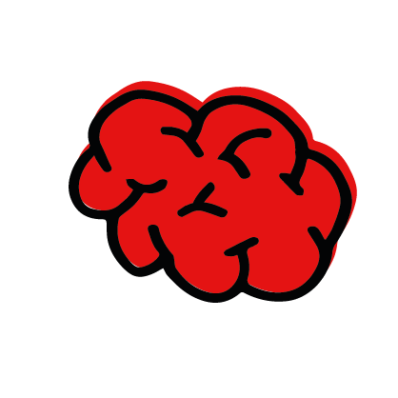
Newsthink.
Israel and the Occupied Palestinian Territory
© British Red Cross 2023. All Images © British Red Cross 2023 unless otherwise stated.
This resource and other free Eeducational materials are available at www.redcross.org.uk/education
The British Red Cross Society is a charity registered in England and Wales (220949) and Scotland (SC027738).

Slide 2

Newsthink.
Israel and the Occupied Palestinian Territory
Learning objectives:
Learn about the humanitarian consequences of armed conflicts.
Apply your learning and practise empathy to understand why following International Humanitarian Law – the rules of war – is an important way to reduce suffering during armed conflicts.
Share your learning by discussing a statement and showing active listening skills.
Notes:
Rules of war are also known as International Humanitarian Law (IHL). They are summarised below. Alternatively, you can watch the animated video on slide 10 or use the URL here - https://youtu.be/HwpzzAefx9M
Protect those who are not fighting, such as civilians, medical personnel or aid workers.
Protect those who are no longer able to fight, like an injured soldier or a prisoner.
Prohibit directly targeting civilians.
Recognise that civilians should be protected from the dangers of war and receive the help they need. Every possible care must be taken to avoid harming them or their houses, or destroying their means of survival, such as water sources, crops, livestock, etc.
The sick and wounded should be cared for, regardless of whose side they are on.
Medical workers, medical vehicles and hospitals should not be attacked.
Torture and degrading treatment of prisoners is prohibited.
Prisoners of war and detainees must be treated humanely and be allowed to communicate with their loved ones.
There are limits on the weapons and tactics that can be used in war in order to avoid unnecessary suffering.
Rape or other forms of sexual violence are prohibited.

Slide 3
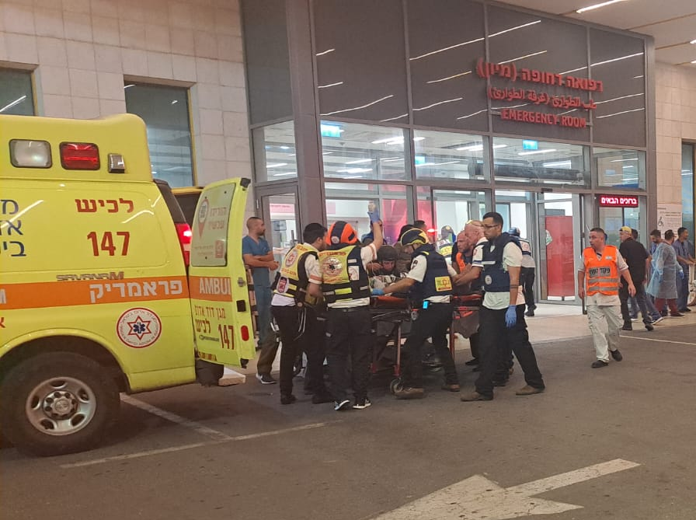
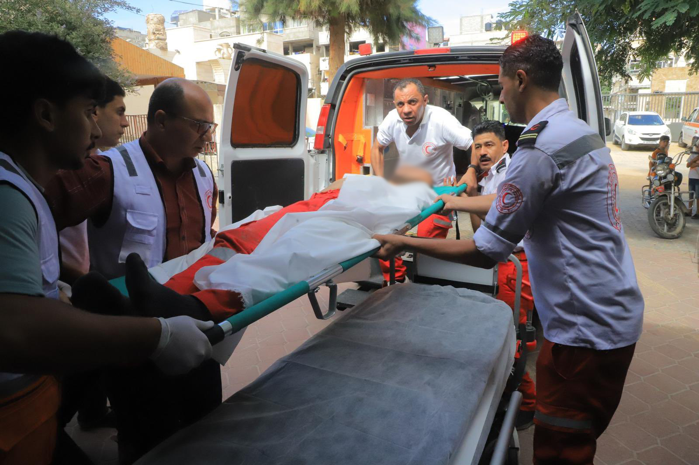

Newsthink.
See: What do you see? Who is in this picture and what is happening?
Notes:
Give learners the opportunity to guess who the people may be, why they are there and what they may be doing.
Extra notes:
There has been an ongoing conflict in Israel and the Occupied Palestinian Territory for many years. On Saturday 7th October the conflict escalated around the border between Israel and Gaza. Reports suggest that as of 19th October 2023, over 4,100 people have been killed in Israel and the Gaza Strip, with thousands more injured.
The International Red Cross and Red Crescent Movement is responding to the crisis through the International Committee of the Red Cross (ICRC) and National Societies in the region. Pictured here are paramedic teams from two National Societies: Magen David Adom (Red Star of David) in Israel (left) and the Palestine Red Crescent Society (right).
Teams were already on the ground when the conflict escalated and have been responding to urgent humanitarian needs with vital aid and support, including providing first aid, ambulances, and medical support to all sides.
Both photographs were taken during the recent escalation in hostilities.
Photo credit: Magen David Adom (left); Palestine Red Crescent Society (right)

Slide 4
Newsthink.
Think: What do you think these people are thinking about? What is important to them at this moment?
Notes:
Mission of the International Red Cross and Red Crescent Movement
The mission of the Movement is “to prevent and alleviate human suffering wherever it may be found, to protect life and health and ensure respect for the human being, in particular in times of armed conflict and other emergencies, to work for the prevention of disease and for the promotion of health and social welfare, to encourage voluntary service and a constant readiness to give help by the members of the Movement, and a universal sense of solidarity towards all those in need of its protection and assistance.”

Slide 5
Newsthink.
Feel: How do you think they feel? Will they each feel the same worries? Why might they feel this way?
Notes:
Magen David Adom in Israel, the Palestine Red Crescent Society and the International Committee of the Red Cross were already present in the region before the recent escalation in violence.
They responded immediately and teams are continuing to help people.
Even so, sadly, first responders from both Magen David Adom and the Palestine Red Crescent have lost their lives while carrying out their work.
What is International Humanitarian Law?
International Humanitarian Law (IHL), known informally as the ‘rules of war’, limits the suffering caused by armed conflict. It protects individuals who are not (or are no longer) participating in the fight and restricts the means and methods of warfare.
What do the rules of war say about wounded people and medics?
It is forbidden to attack an enemy fighter who is no longer in the fight owing to injury or sickness.
The wounded and sick should be collected and cared for.
Medics and other healthcare professionals must care for the sick and wounded impartially – this means they must give care based on medical need alone.
Medical personnel, facilities, transports and equipment should be protected. The emblem of the red cross, red crescent, and red crystal are the visible signs of such protection and must be respected.
Medics should be permitted to go where they are needed most and not targeted or harassed as they perform their life-saving work.
Why is it important to know the ‘rules of war’?
Everyone fighting in an armed conflict needs to respect IHL, both governmental forces and non-State armed groups. If the rules of war are broken, there can be consequences. Individuals can be prosecuted for particularly serious violations of these rules, which are called “war crimes”. Even when cases are not tried in a court, governments or armed groups that violate the law can be criticised by the media, civil society groups or individual members of the public.
The International Red Cross and Red Crescent Movement has a special relationship with the Geneva Conventions (which are the core element of IHL). These treaties have been ratified by all 196 states and are universal. Very few international treaties have this level of support.
Find out more here: www.redcross.org.uk/about-us/what-we-do/protecting-people-in-armed-conflict/international-humanitarian-law

Slide 6
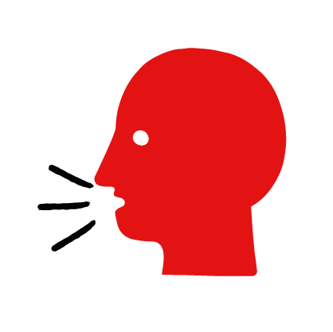

Newsthink.
“It is ok for fighters to target medics who provide first aid
to the enemy."
Agree
Disagree
Notes:
Give learners the opportunity to share their answers. Once they’ve listened to each other’s arguments, give them a chance to review their position. If they wish to change sides, encourage them to do so.
The rules of war forbid the targeting of medics.
Medics should be allowed to carry out their life-saving work without harassment – even when they are caring for wounded enemies.
Medics only lose their protection if they engage in the fighting.

Slide 7
Newsthink.
“It is important for medics to help wounded civilians and fighters from both sides."
Agree
Disagree
Notes:
Give learners the opportunity to share their answers. Once they’ve listened to each other’s arguments, give them a chance to review their position. If they wish to change sides, encourage them to do so.
The rules of war provide medics with protection and make it easier for them to reach people in need. However, medics also have responsibilities. For instance, to remain protected, medics must not participate in the fighting.
They also must give assistance on the basis of impartiality. This means that they must help the wounded from both sides according to medical need alone.
In addition, members of the International Red Cross and Red Crescent Movement (which includes Magen David Adom) are expected to follow the Fundamental Principles of the International Red Cross and Red Crescent Movement. Three of these principles are especially important during armed conflicts:
Impartiality -The Movement makes no discrimination as to nationality, race, religious beliefs, class or political opinions. It endeavours to relieve the suffering of individuals, being guided solely by their needs, and to give priority to the most urgent cases of distress.
Neutrality - In order to continue to enjoy the confidence of all, the Movement may not take sides in hostilities or engage at any time in controversies of a political, racial, religious or ideological nature.
Independence - The Movement is independent. The National Societies, whilst auxiliaries in the humanitarian services of their governments and subject to laws of their respective countries, must always maintain their autonomy so that they may be able at all times to act in accordance with the Principles of the Movement
---
These principles are key in situations like the current escalation in violence in Israel and the Occupied Palestinian Territory. It helps the Red Cross & Red Crescent Movement to build trust with communities, to reduce the chances of being targeted -- and ultimately to gain access to people in need.
More information on the principles of the International Red Cross Red Crescent Movement can be found here: https://www.redcross.org.uk/about-us/what-we-stand-for?c_code=175151&c_source=google&c_name=&adg=about%20us%20|%20catchall&c_creative=dsa&c_medium=cpc&gclid=EAIaIQobChMI2cWqoc_6gQMVCoGDBx0qPwYLEAAYASAAEgKfivD_BwE

Slide 8

Newsthink.
Reflect on your own:
What are your thoughts and feelings about this image and the events you talked about?
Notes:
This is an extension task for personal reflection. Encourage learners to reflect on this activity, whether writing it down or just thinking.

Slide 9



Newsthink.
Learn more:
Learn more about conflict and its consequences with our Rules of War resource.
Share with others:
Share what you’ve learned with others. Show them the rules of war, discuss the debate with them, or reflect together on how you feel about this event.
Do something:
Share the rules of war with others to spread information on the importance of them in helping maintain humanity, save lives and reduce suffering during conflict.
Notes:
Some ideas of what you and your learners can do next.

Slide 10
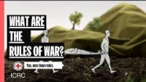
Notes:
If this slide does not play correctly, the video can be accessed at: https://youtu.be/HwpzzAefx9M

