Slide 1
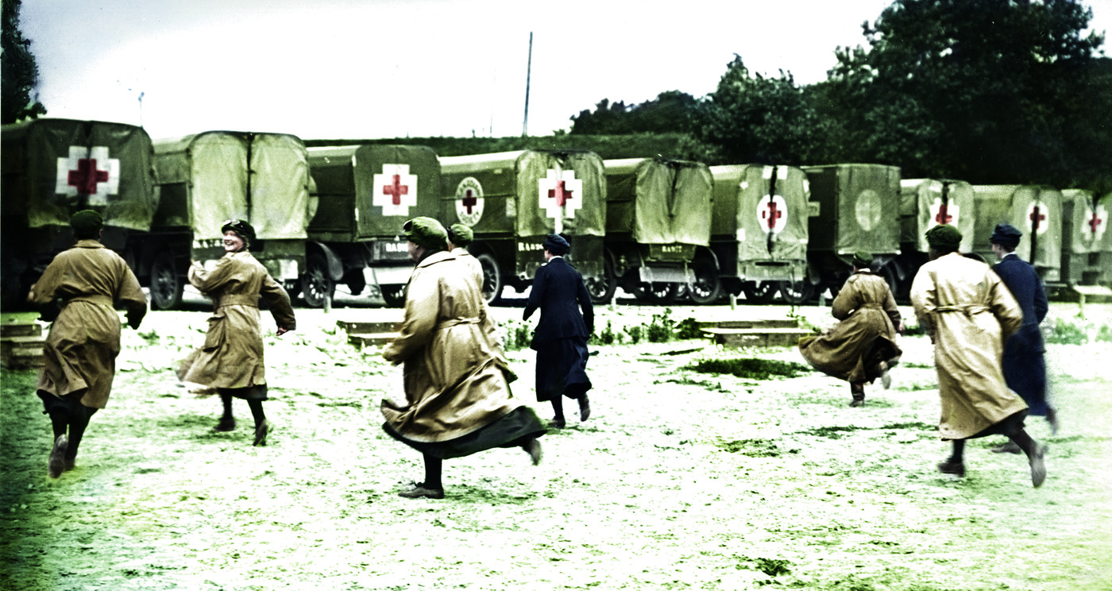
Rules of War
Notes:
Source: British Red Cross StoriesHub (colourised image)

Slide 2
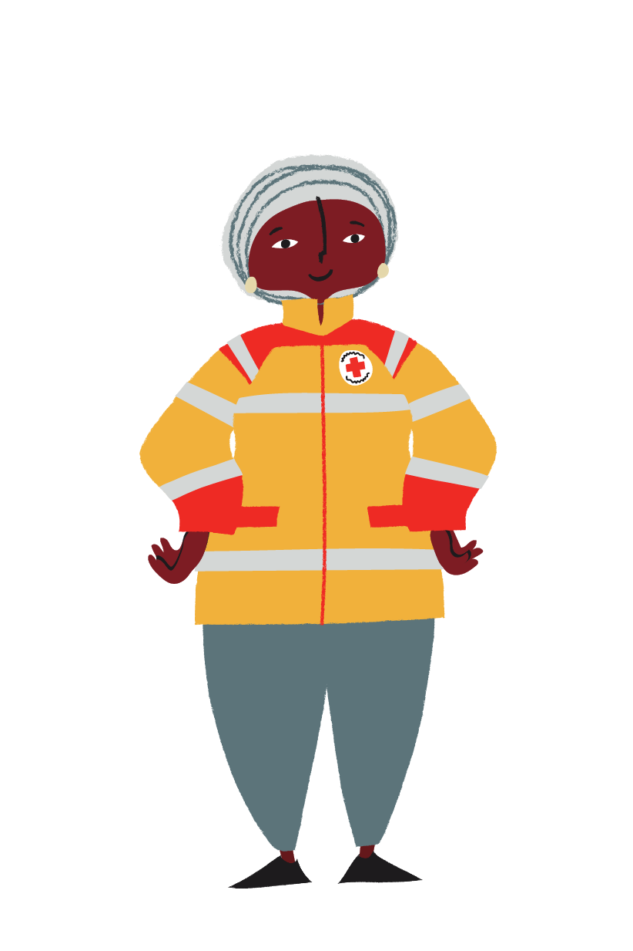
Learning outcomes
Share your thoughts on the importance of International Humanitarian Law.
Learn about the rules of war.
Apply your knowledge to decide what is legal during armed conflict.

Slide 3

What rules should you follow?
Discuss what rules you think you are expected to follow in your life.
Write down your answer.

Slide 4
Starter
International law
Local and UK laws
Think about the rules you must follow in your life.
Copy the circles and fill in your ideas.
School
Home
Why are rules needed?
Notes:
Learners should sort and write any examples they have produced into the circle template.
Answers can be shared to the wider group.
Then ask learners to reflect on why rules are needed? Answers may include safety, social order, protection.
Finish by asking if learners believe that there are situations where rules change or no longer apply? ‘Conflict’ may arise as an answer. Follow this by asking if there are rules in conflict? Collate answers and move onto next activity.

Slide 5
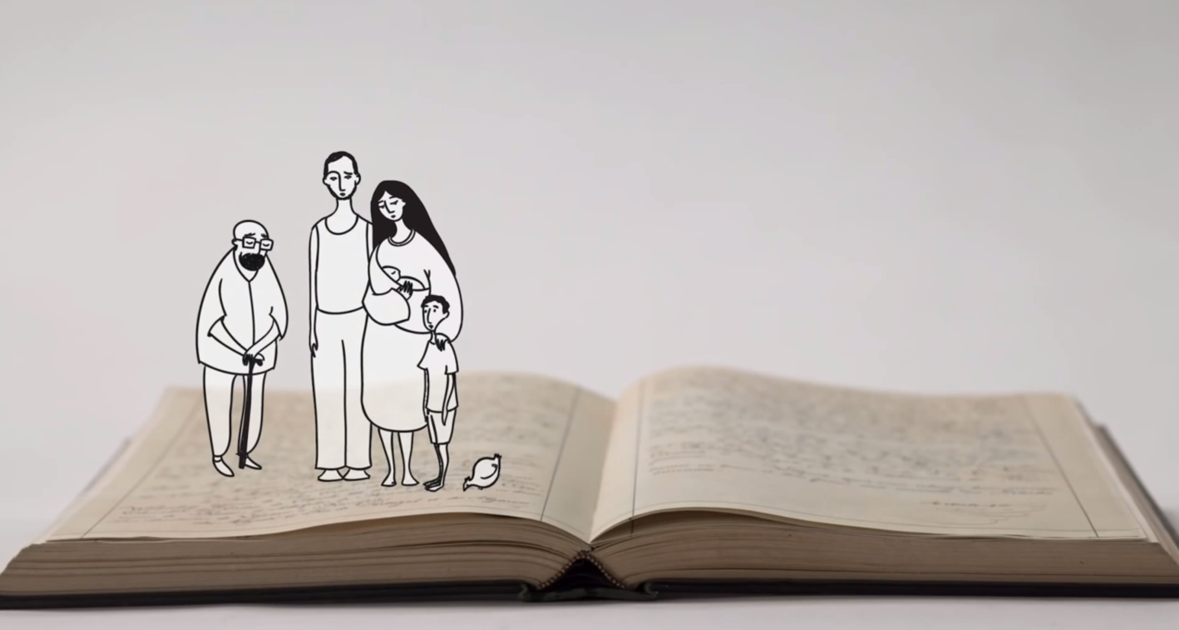
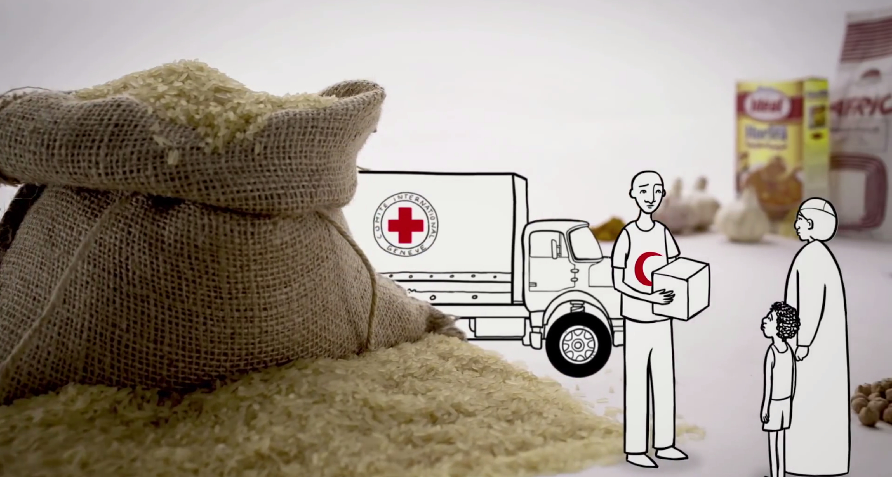
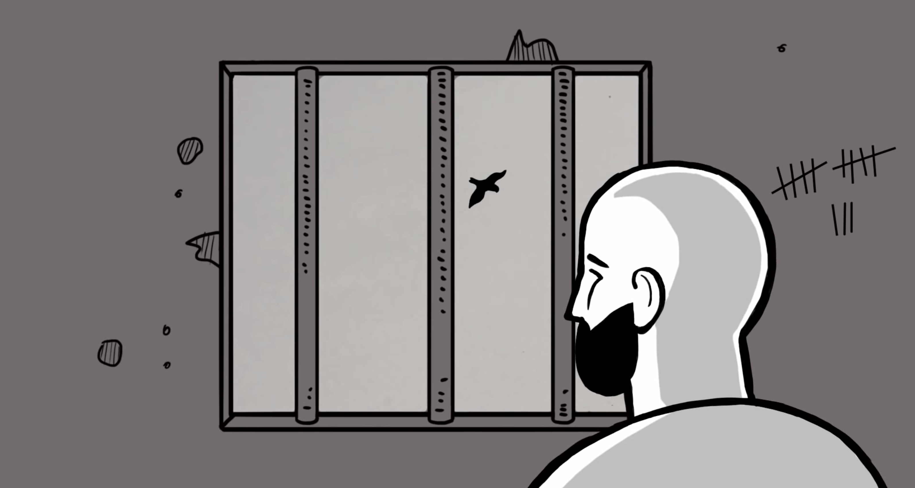
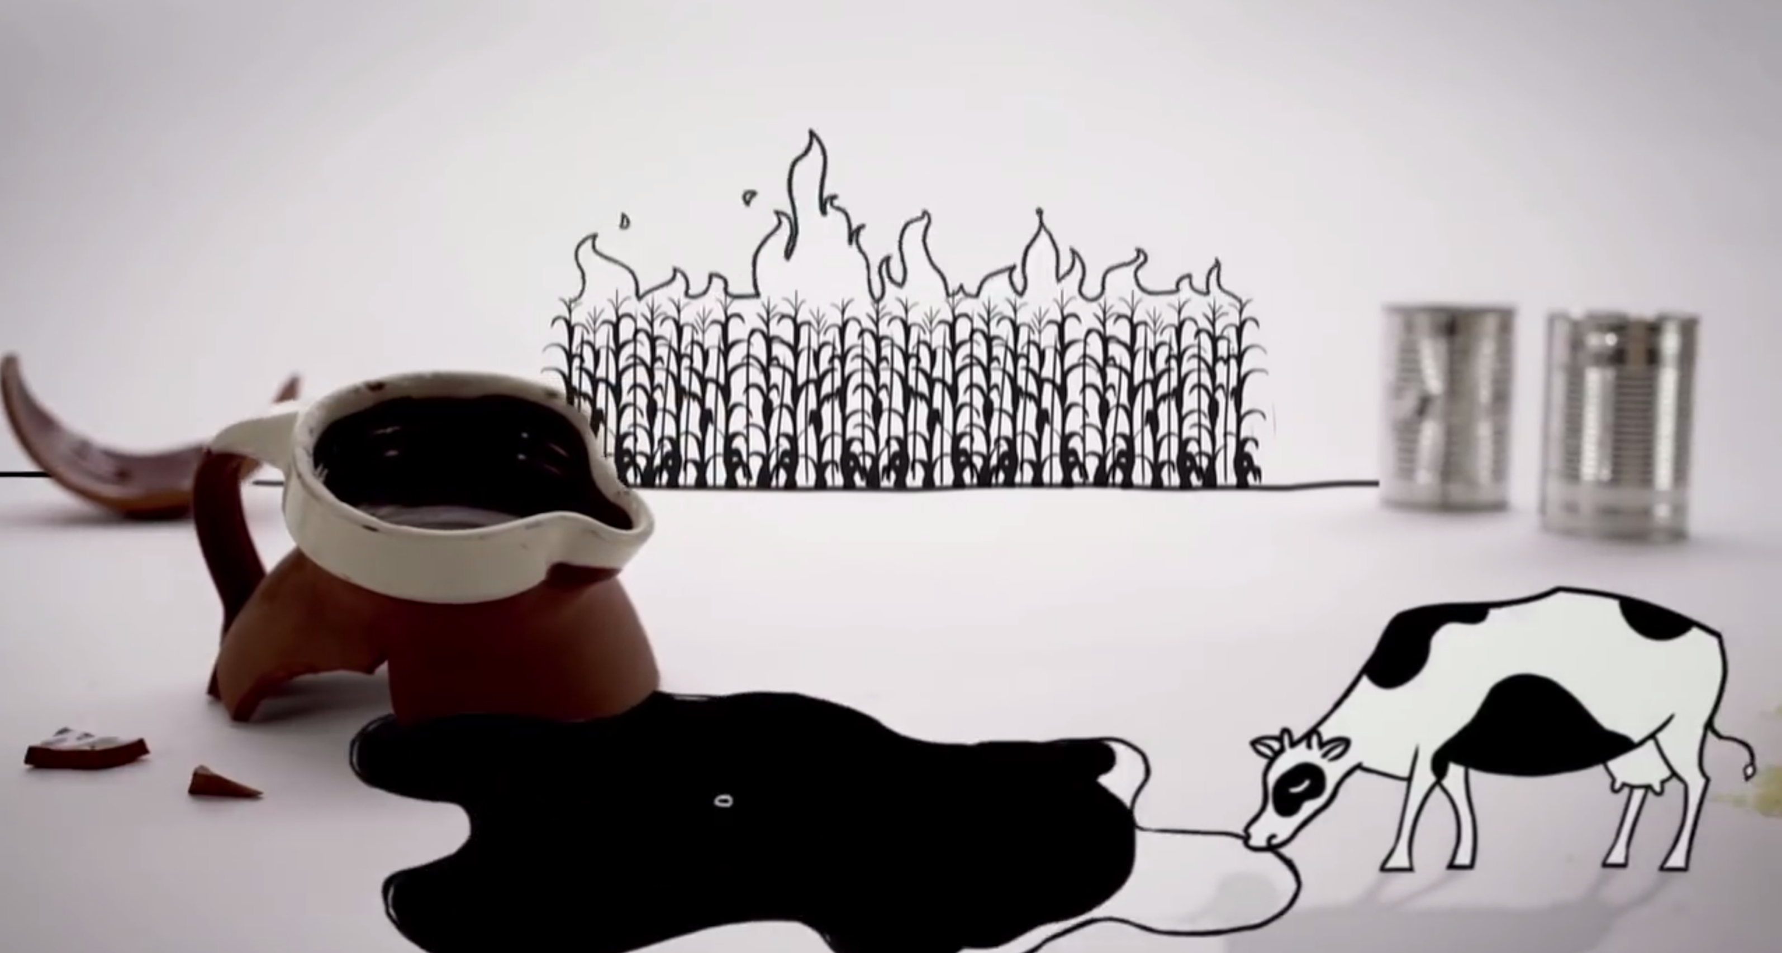
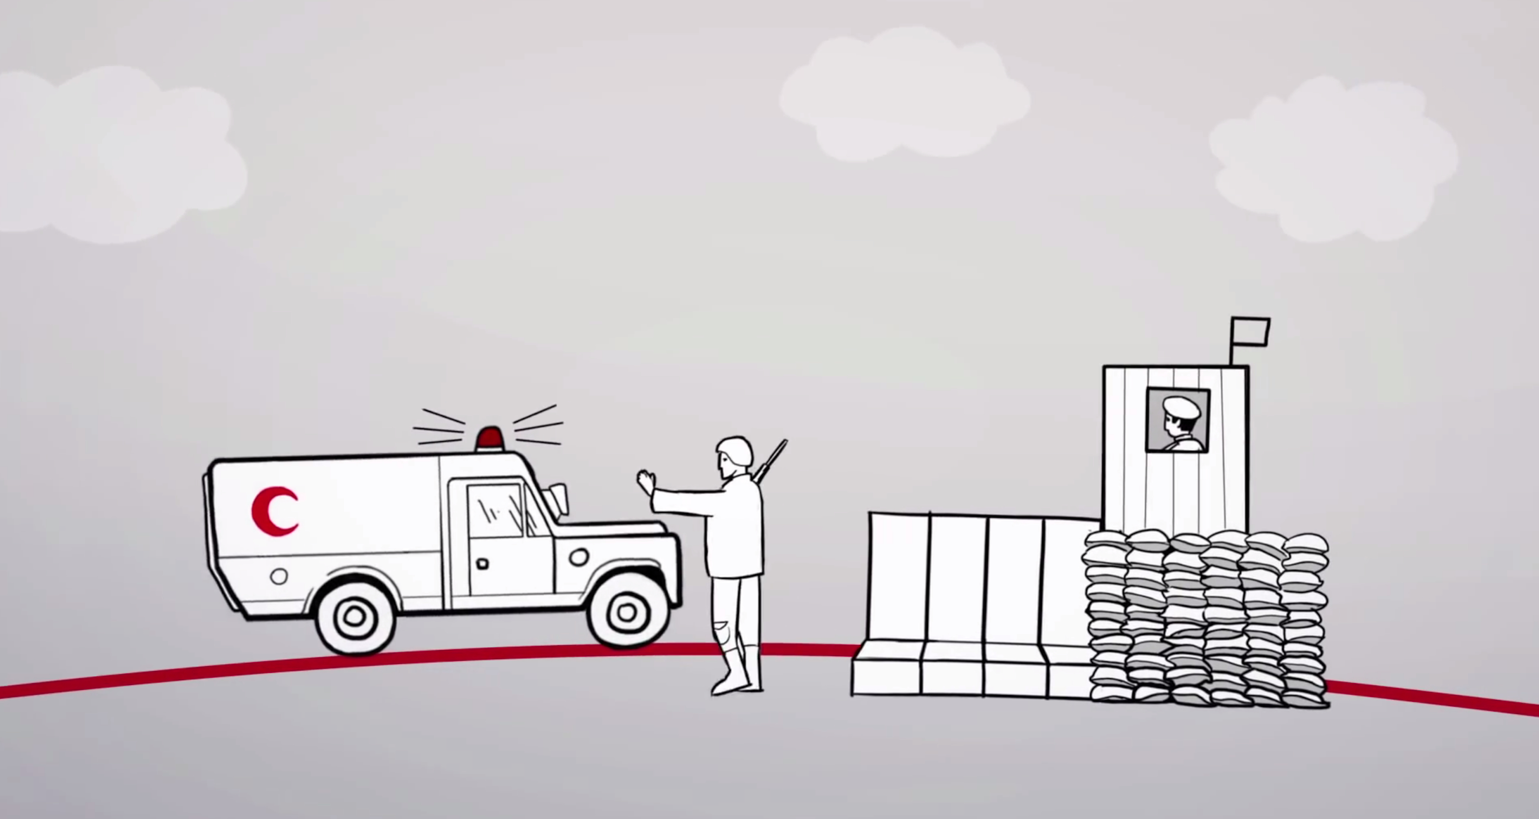
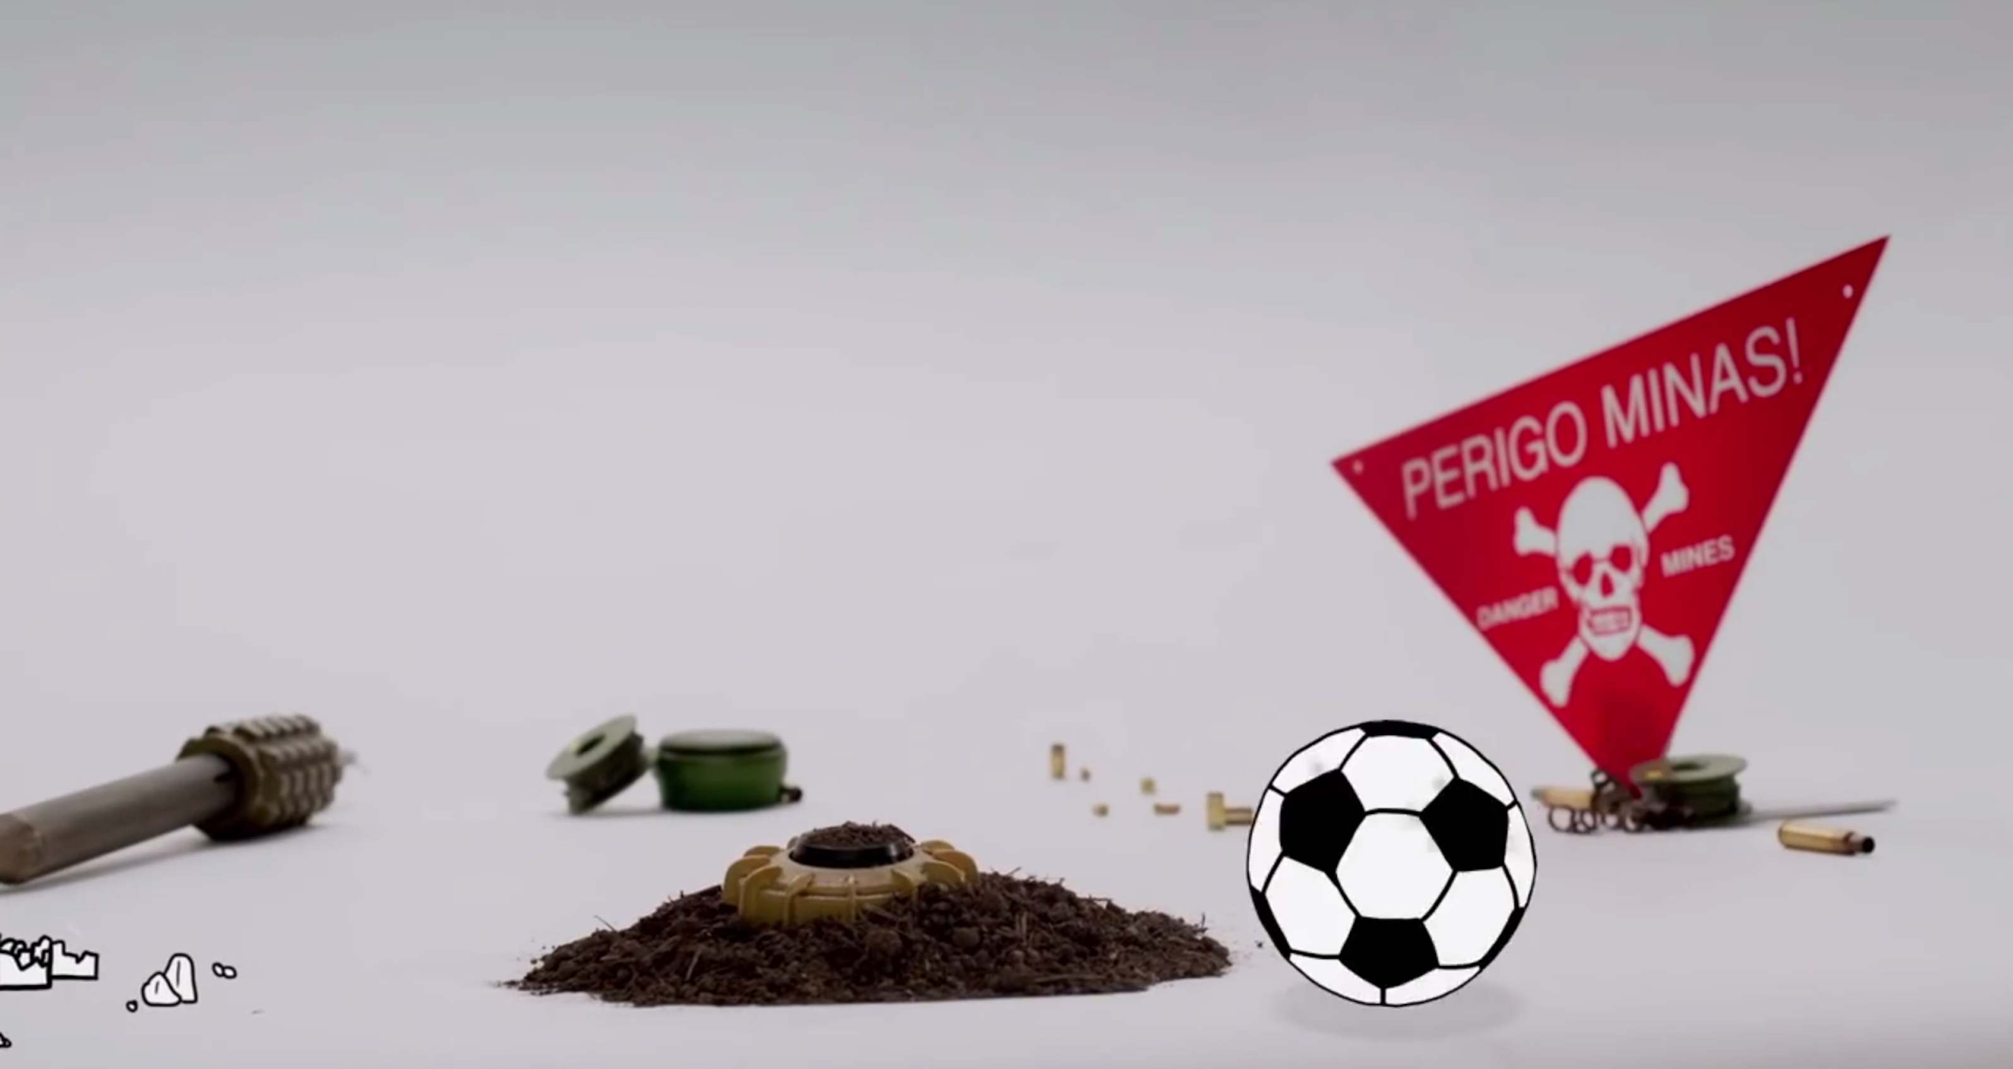
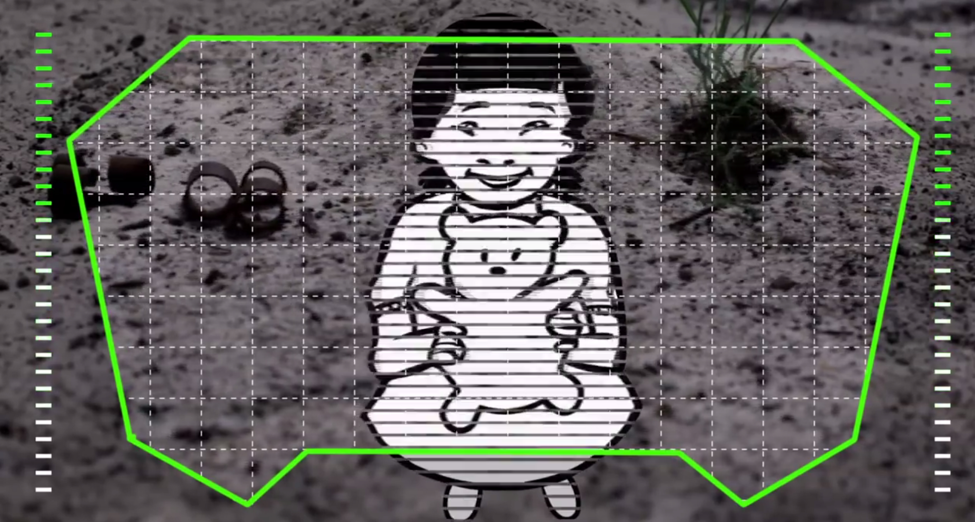
These pictures each show a rule of war.
What do you think the rules are?
Notes:
Place learners in pairs with a single image, or in groups with the collection of images to discuss.
Ask learners to discuss the image/images and think about what rule of war it depicts. Each group can then feed back their ideas to the wider group.

Slide 6
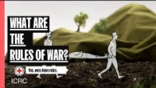
Video
Which rules of war did you guess correctly?
Notes:
The animation introduces two important terms: IHL is a body of law. The Geneva Conventions are treaties that are the cornerstone of IHL. IHL also includes other international treaties.
Rules discussed in the video:
Civilians can never be targeted.
Every possible care must be taken to avoid destroying things essential for civilians’ survival.
Torture and other ill treatment of detainees is prohibited. They must be given food and water and be allowed to communicate with loved ones.
Medical workers must always be allowed to do their job. The Red Cross and Red Crescent must not be attacked. The sick or wounded have a right to be cared for.
Weapons and methods of warfare must be able to distinguish between a military target and a civilian.

Slide 7
Lawful, unlawful or
‘it depends’?
Now you know some rules of war, walk around the room and decide if the image is lawful or unlawful under International Humanitarian Law. Sometimes, you may think it depends on the situation.
Apply
Notes:
Share the terms, ‘lawful’ (legal, acceptable under law), ‘unlawful’ (illegal, unacceptable under law) and ‘it depends’ (the idea of proportionality) with learners at a time of armed conflict. Explain that learners will use what they have learned about the rules of war to apply the terms to the images.
Learners may then walk around the room, placing a sticky note with the term ‘lawful’, ‘it depends’ or ‘unlawful’ on each picture.
Alternatively, a blank piece of paper may be stuck beside the image and students write directly onto the paper.

Slide 8
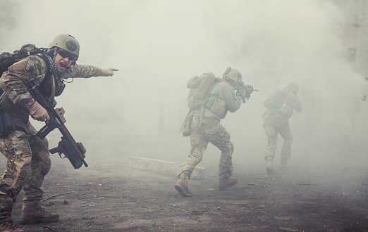
Situation: shooting enemy soldiers during a conflict.
Notes:
Source: iStock/Getty
Photographer: Zebelin
This image is used to depict soldiers during armed conflict and the environment in which they may shoot at each other.

Slide 9
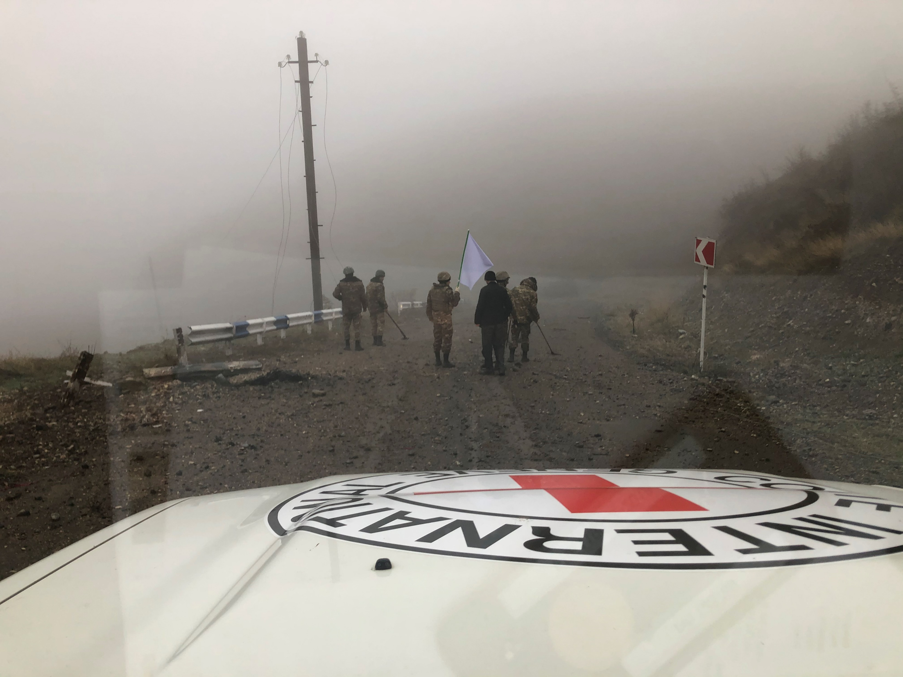
Situation: shooting enemy soldiers who have surrendered.
Notes:
Credit: ICRC
This picture is used to illustrate soldiers surrendering to help stimulate conversation.
Nagorno-Karabakh: conflict aftermath: Winter deepens agony of families of missing people (icrcnewsroom.org)

Slide 10
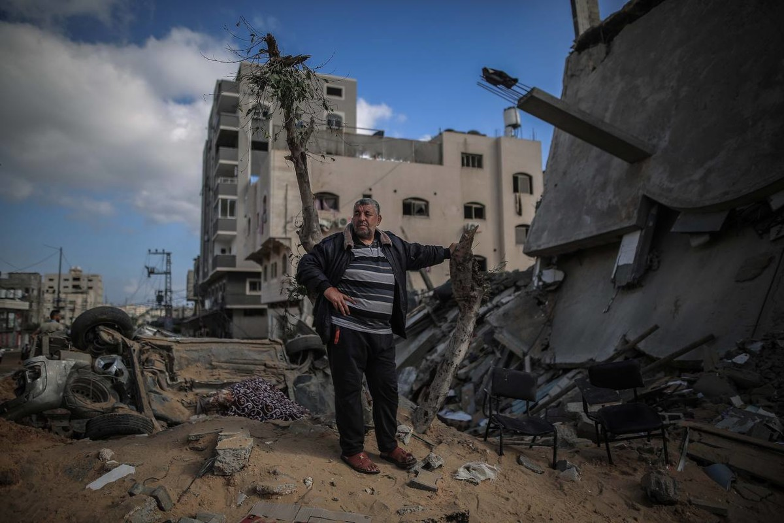
Situation: bombing targets in a city. Many civilians may be killed as a result.
Notes:
Source: BRC
Photographer: Abed Zagout
This picture has been used to show the aftermath of bombing in a city. It does not directly relate to the deaths of civilians.

Slide 11
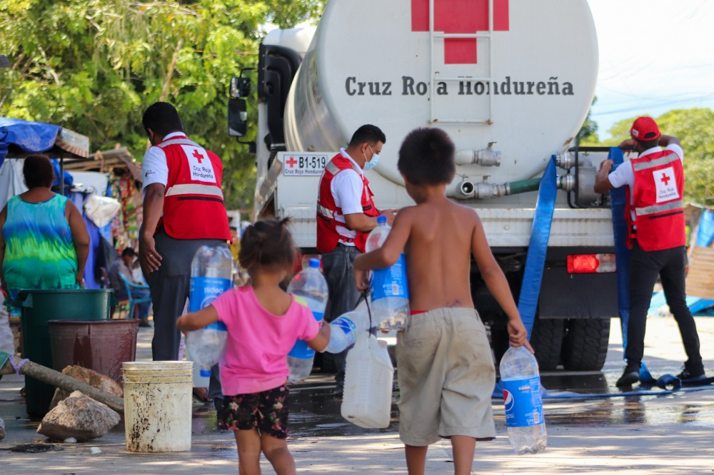
Situation: destroying the only drinking water supply to a city.
Notes:
Source: IFRC
This image is used to depict the provision of water where there is limited/no access. Access to safe drinking water is essential in conflict as well as when climate emergencies.
IFRC launches Global Climate Resilience Platform to support 500 million people on climate crisis frontlines (ifrcnewsroom.org)

Slide 12
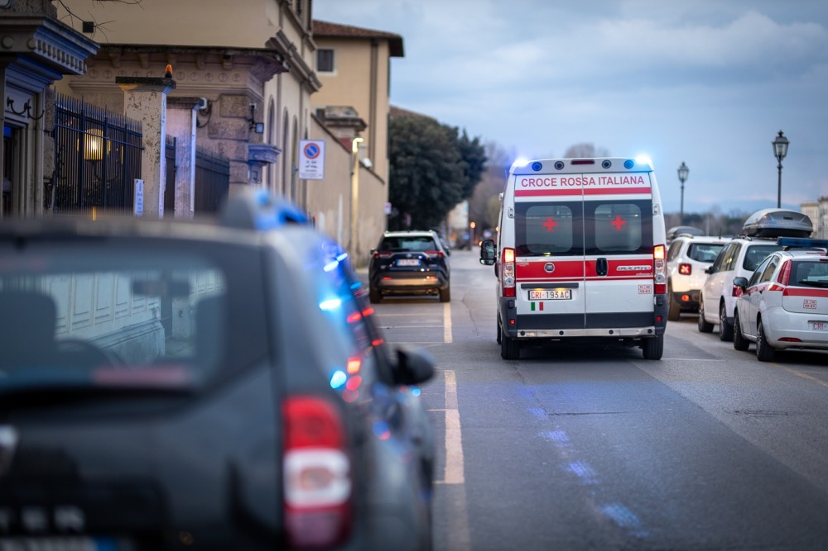
Situation: shelling a Red Cross ambulance which is helping wounded enemy soldiers.
Notes:
Source: ICRC
This photo is used to highlight Red Cross ambulances in use.
Red Cross volunteers take on COVID-19 fight in the community (ifrcnewsroom.org)

Slide 13
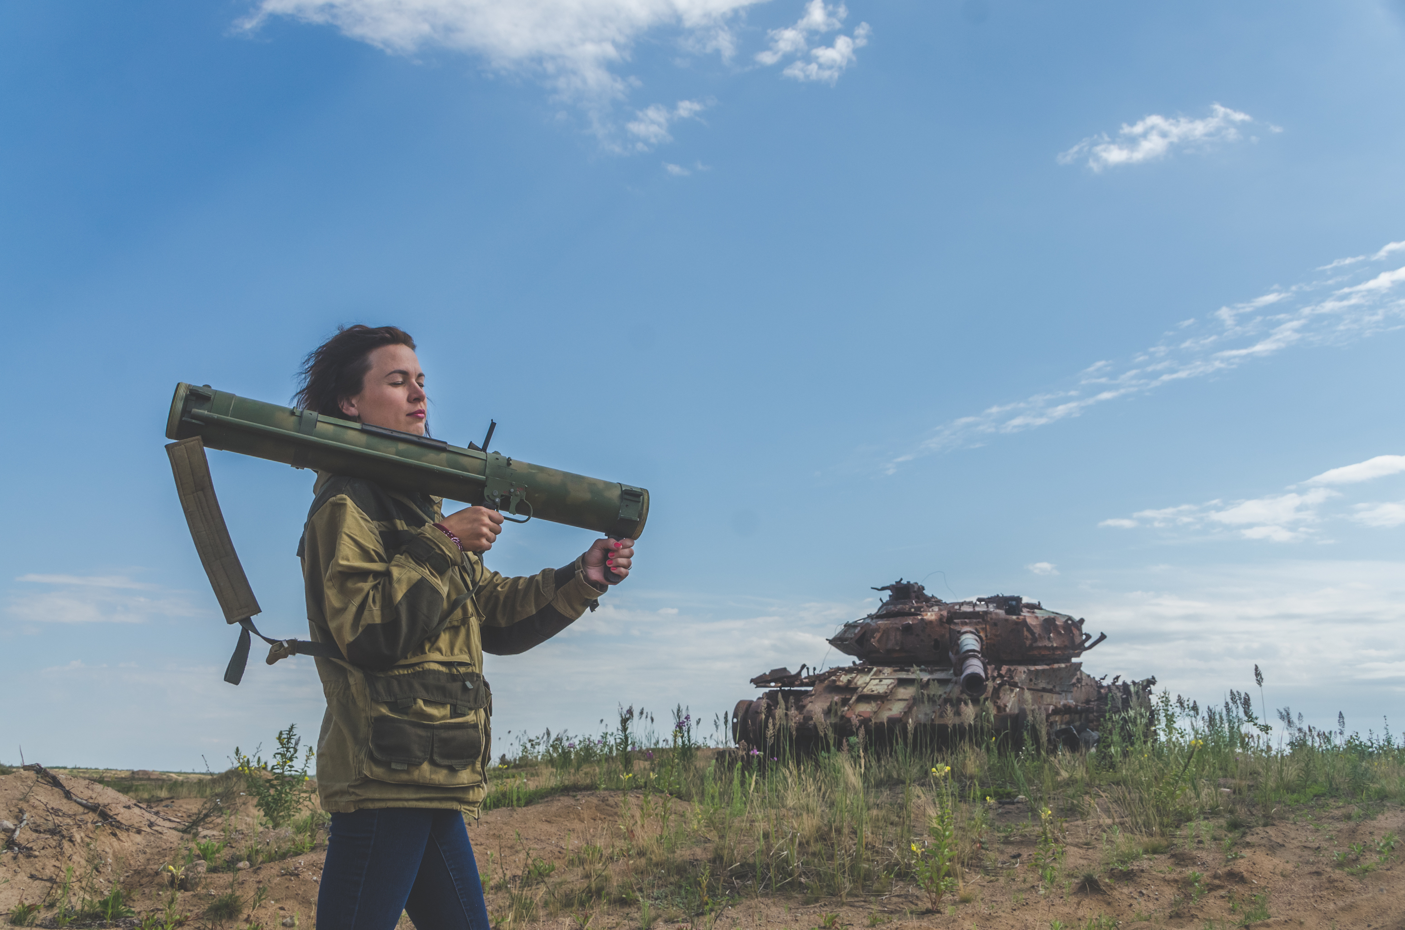
Situation: shooting at enemy soldiers who appear to be children.
Notes:
Source: iStock/Getty
Photographer: DmitryPK
This image is used as a stimulus to highlight young people and children used in conflict situations as combatants. This image is not a legitimate image of a child soldier.

Slide 14
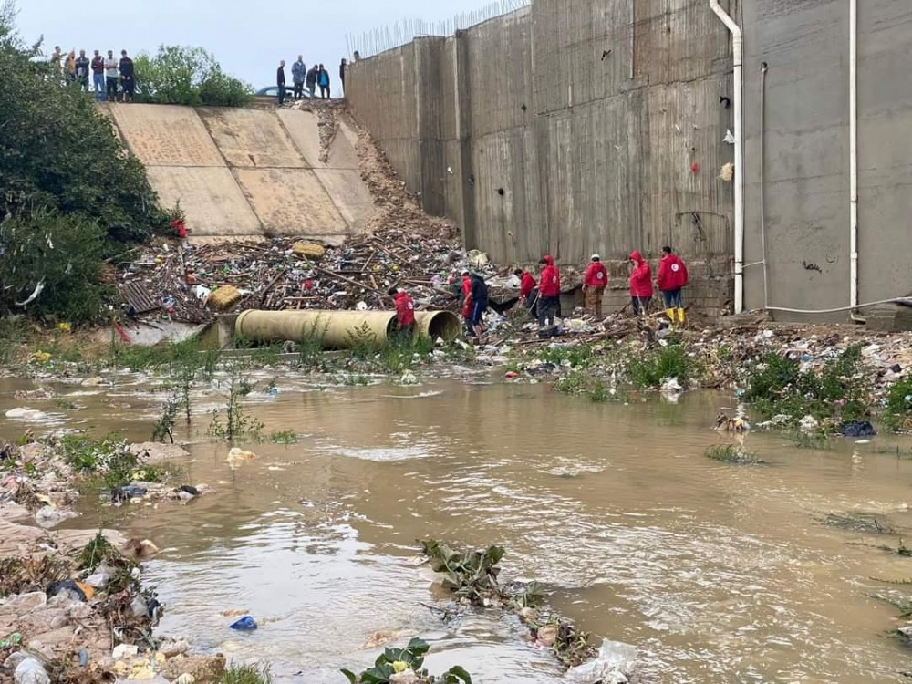
Situation: destroying a dam to gain military advantage.
Notes:
Source: IFRC
This image is to be used as a stimulus to highlight the importance of water supply. Conflict can prevent key infrastructure from being maintained and may be targeted to gain military advantage.
Libya floods: IFRC announces CHF 10 million appeal for urgent relief efforts (ifrcnewsroom.org)

Slide 15
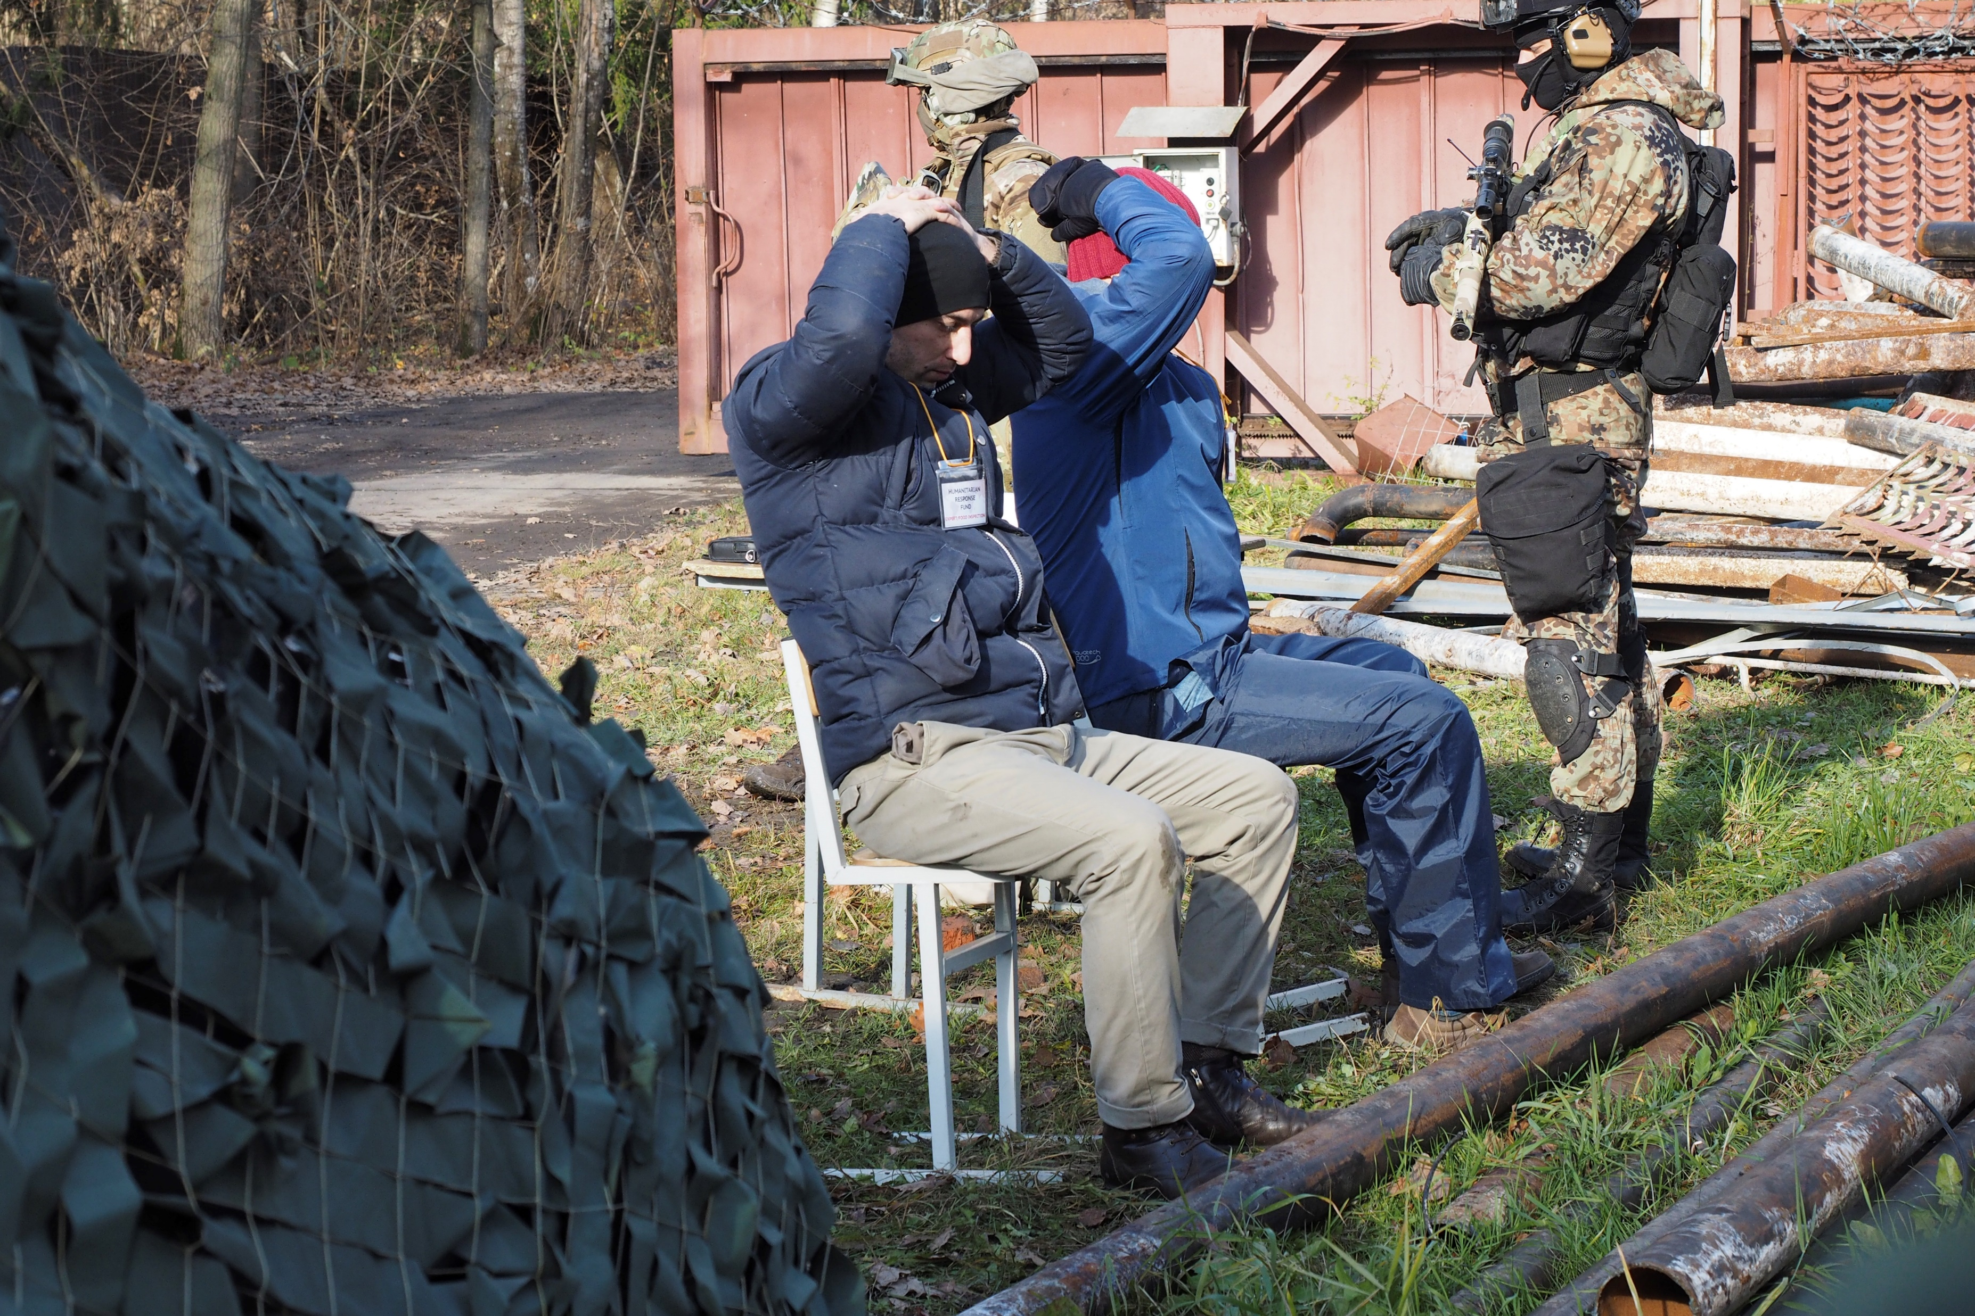
Situation: taking hostages during an armed conflict.
Notes:
Source: ICRC audiovisual archives
This image is a simulation exercise that the ICRC conducts during a course on safety and security for journalists in the Moscow area, it is not a photo of real hostage situation. (2018)

Slide 16
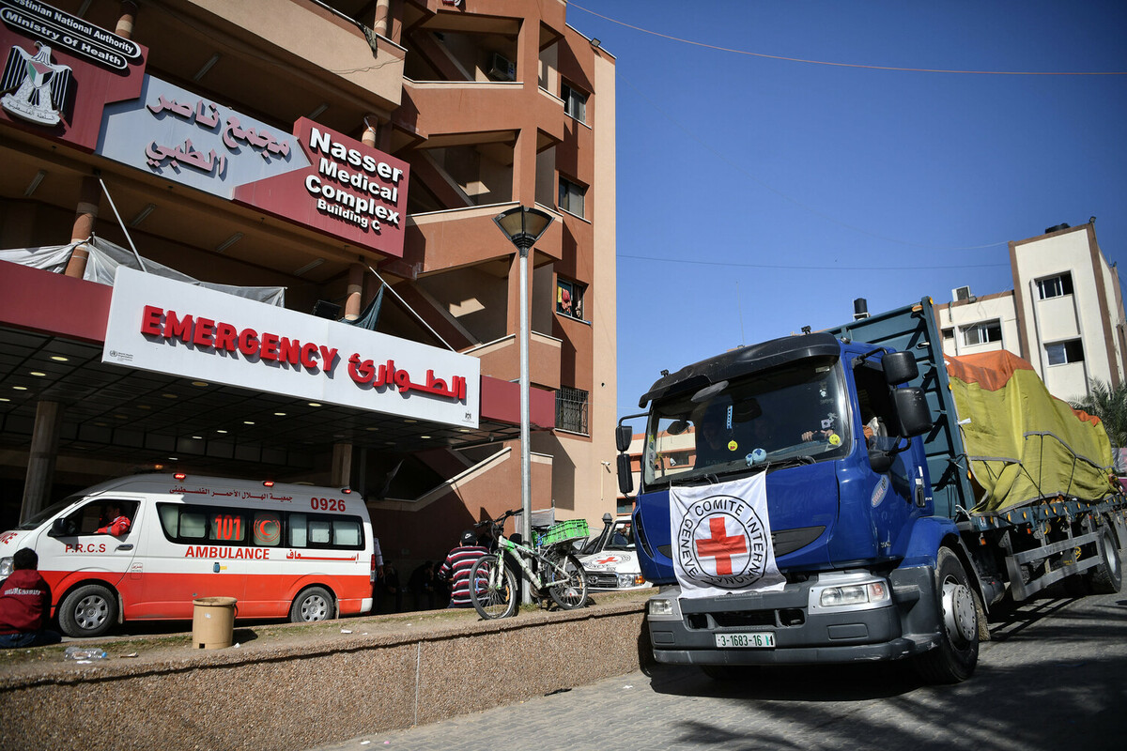
Situation: Shelling a hospital from which snipers are killing your soldiers.
Notes:
Source: BRC
Photographer: Abed Zagout
This photo is used as a stimulus to highlight the position of hospitals and their importance during armed conflict. This photo does not depict a hospital being used by snipers or being shelled.

Slide 17
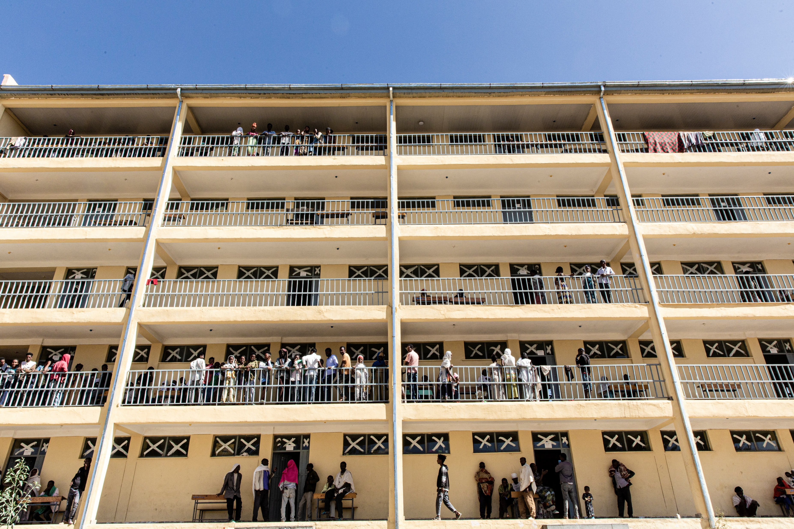
Situation: placing a military base right next to civilian buildings to shield it from attack.
Notes:
Source: ICRC audiovisual archives
This picture does not show a human shield situation. It depicts lots of civilians in a building in Axum, in the Tigray region of Ethiopia which has increased in population since the crisis in November 2020.

Slide 18
Order the pictures
Apply
Lawful
It depends
Unlawful
Notes:
Share the terms, ‘lawful’ (legal) and ‘unlawful’ (illegal) with learners at a time of armed conflict. Explain that learners will use what they have learned about the rules of war to apply the terms to the images.
Learners may then walk around the room, placing a sticky note with the term ‘lawful’, ‘unlawful’ or ‘it depends’ on each picture.
Alternatively, a blank piece of paper may be stuck beside the image and students write directly onto the paper.

Slide 19
Enemy soldiers are lawful targets until they surrender or are no longer able to fight owing to sickness or wounds.
Lawful
Situation: shooting enemy soldiers during a conflict.
Notes:
Military necessity
- Forces should only engage in those acts necessary to accomplish a legitimate military objective e.g. submission of enemy as quickly as possible.
Distinction
- Fighters must at all times distinguish between legitimate military targets and targets which are protected from direct attack. Uniforms, carrying arms openly or clearly participating in hostilities can mark people as combatants.

Slide 20
Surrendering soldiers only lose their protection if they attempt to fight on after having surrendered.
Unlawful
Situation: shooting enemy soldiers who have surrendered.
Notes:
Distinction and humane treatment
- People fighting in an armed conflict must distinguish between civilians and combatants, and between civilian objects and military objectives.
- Everyone should be treated humanely and not be discriminated against.

Slide 21
Situation: bombing targets in a city. Many civilians may be killed as a result.
It depends
The anticipated military advantage must exceed the expected harm caused to civilians. This is called 'proportionality'.
Notes:
Proportionality
It is prohibited to launch an attack which would cause incidental loss of civilian life, injuries and damage to property which would be excessive in relation to the concrete and direct military advantage anticipated.

Slide 22
IHL protects 'objects indispensable to the survival of the civilian population'
Unlawful
Situation: destroying the only drinking water supply to a city.
Notes:
Distinction
- People fighting in an armed conflict must distinguish between civilians and combatants, and between civilian objects and military objectives. Attacks must never be intentionally directed against civilians or objects which are indispensable for their survival, such as food warehouses or water treatment plants.

Slide 23
Situation: shelling a Red Cross ambulance which is helping wounded enemy soldiers.
Unlawful
It does not matter who the medics are helping. They should always be respected and protected.
Notes:
Distinction
- People fighting in an armed conflict must distinguish between civilians and combatants, and between civilian objects and military objectives. Attacks must never be intentionally directed against civilians or objects which are indispensable for their survival, such as food warehouses or water treatment plants.

Slide 24
Situation: shooting at enemy soldiers who appear to be children.
Lawful
If they participate in the fighting, children may become lawful targets. This is why it is unlawful to recruit children into armed forces or armed groups.
Notes:
Distinction
- Fighters must at all times distinguish between legitimate military targets and targets which are protected from direct attack. Uniforms, carrying arms openly or clearly participating in hostilities can mark people as combatants.
BUT the crime is recruiting child soldiers. Children under 15 should not be recruited into the armed forces. It is a violation of International Humanitarian Law to recruit and use children in hostilities.

Slide 25
Situation: destroying a dam to gain military advantage.
Unlawful
'Dam-busting' was permitted in the past, but this is no longer the case. The civilian harm it causes is too great.
Notes:
Distinction
- People fighting in an armed conflict must distinguish between civilians and combatants, and between civilian objects and military objectives.
Attacks must never be intentionally directed against civilians or objects which are indispensable for their survival, such as food warehouses or water treatment plants.

Slide 26
Situation: taking hostages during an armed conflict.
Unlawful
What is hostage taking? In armed conflict, this is where combatants hold one or more people who are protected by the Geneva Conventions and then threaten to kill, injure or continue to detain them in order to compel others to act or to stop acting in a certain way.
Notes:
Hostage taking
The taking of hostages is prohibited by international humanitarian law (as formulated in Customary IHL (CIHL) Rule 96).

Slide 27
Situation: Shelling a hospital from which snipers are killing your soldiers.
It depends
Hospitals may lose their protection if they are used to commit acts harmful to a party to the conflict. However, their protection only stops after a warning has been given - setting a reasonable time-limit - and after that warning has been ignored. Proportionality must be observed.
Notes:
Distinction
People fighting in an armed conflict must distinguish between civilians and combatants, and between civilian objects and military objectives. Attacks must never be intentionally directed against civilians or objects which are indispensable for their survival, such as food warehouses or water treatment plants.
Hospitals have an additional level of protection under IHL. Armed groups must give hospitals advanced warnings to allow hospital staff enough time to evacuate.

Slide 28
Situation: placing a military base right next to civilian buildings to shield it from attack.
Unlawful
The use of human shields is prohibited. For their part, attackers must still observe proportionality.
Notes:
Human Shields: Rule 97
The term ‘human shield’ as used in international humanitarian law means a civilian placed in front of a military objective so that his civilian status will deter the enemy from attacking that objective. This could be locating a military act in a residential area. The use of human shields is absolutely forbidden. The law also places obligations on the party under attack to take precautions against the effects of attacks. This is addressed in the Geneva Conventions.
Source: https://ihl-databases.icrc.org/en/customary-ihl/v1/rule97

Slide 29

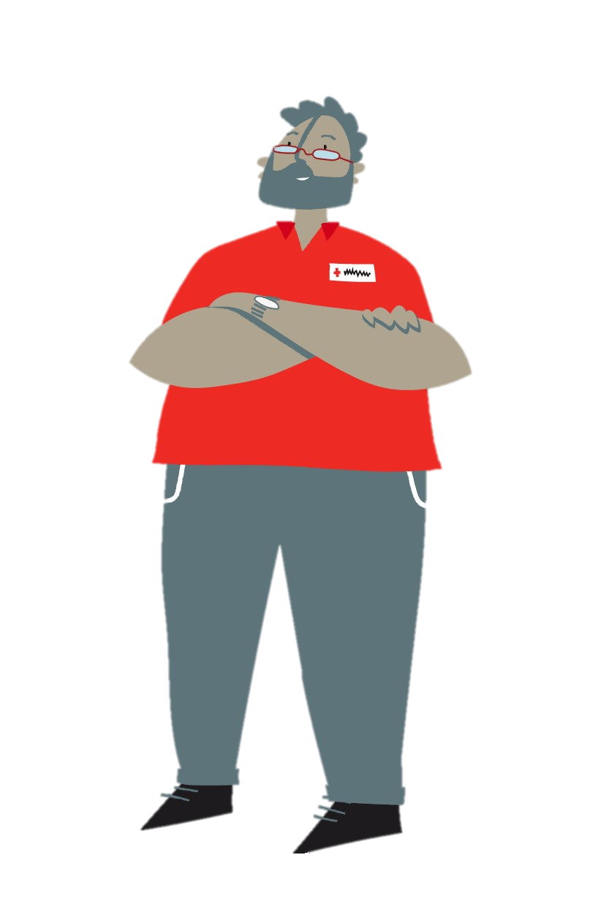

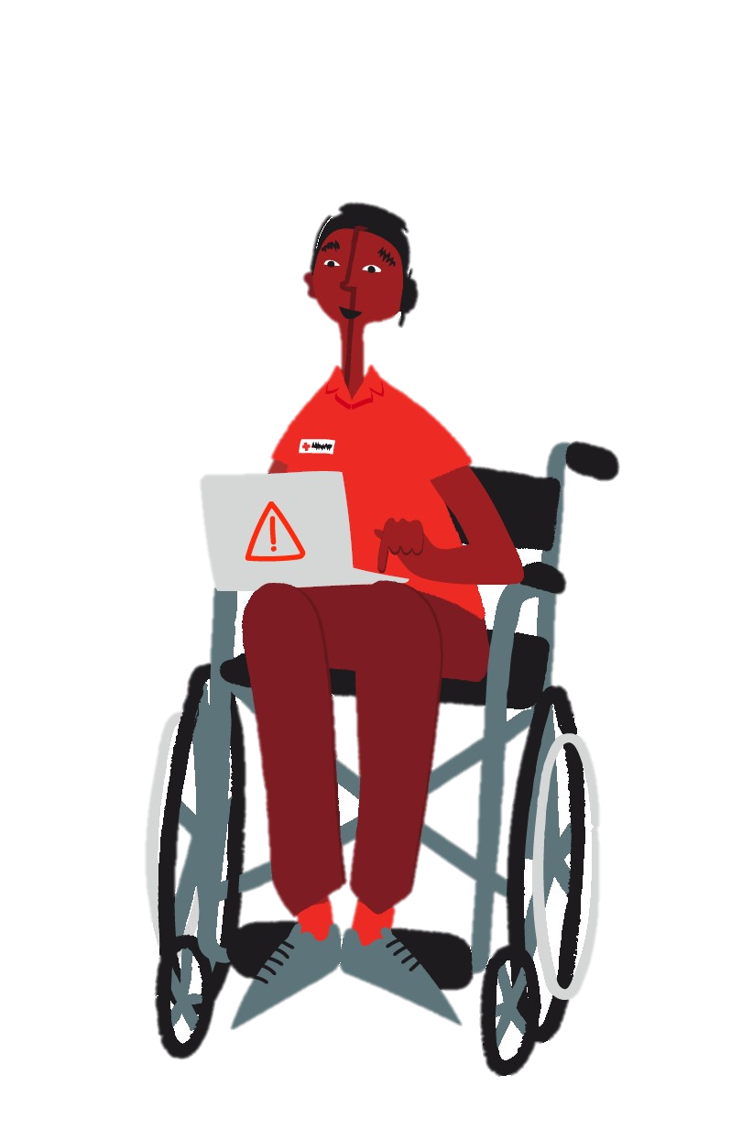
Who needs to know about the rules of war?
Share
Write down your answer.

Slide 30




How can the rules of war be shared?
Share
Notes:
Writing
Talking to someone
Sharing on social media
Creating an event to talk about rules of war
Learners can swap their answers with a partner or keep their list to themselves. If lists have been swapped with a partner, the partner will write their answers on the other persons list.
This activity can be created centrally on a white board.

Slide 31
Class project
Debate
Assembly
How can you share the rules of war in your school?
Choose one of the ideas or come up with your own to spread what you know about the rules of war.
Posters
Videos
Quiz

